Slide 1
VOLUMETRIC VIDEO // PLENOPTIC LIGHTFIELD // MULTI CAMERA METHODOLOGIES
JORDAN HALSEY // VR PLAYHOUSE

Slide 2
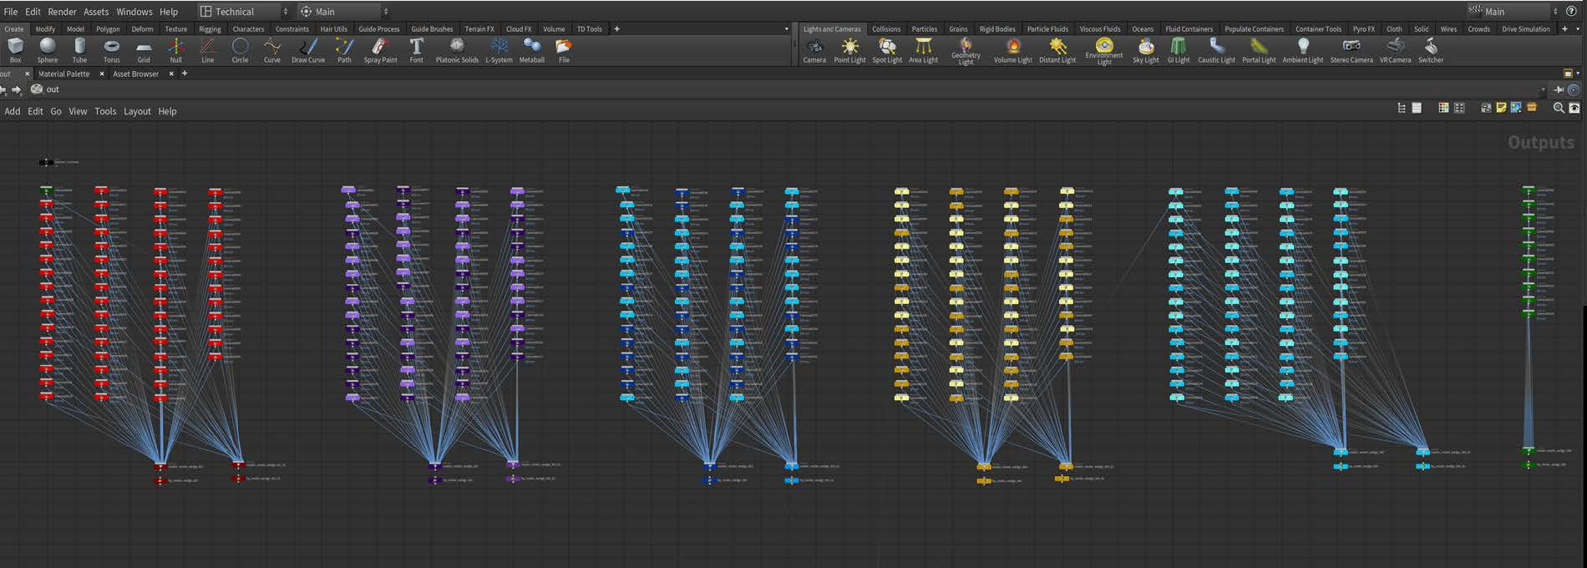

VOLUMETRIC VIDEO // PLENOPTIC LIGHTFIELD // MULTI CAMERA METHODOLOGIES
Pro: Highly realistic seated viewing experience Large lighting datasets
Reflections and refractions behave as n the real world
 |  |  | Con: | Extremely large datasets
 |  |  |  | Playback is view dependent
 |  |  |  | Cgi integration and post effects need to be rendered with exact camera matching
 |  |  |  | Rendering, rendering, rendering...
 |  |  |  | Complicated file structure
 |  |  |  | Necessity for highly controlled lighting

Slide 3
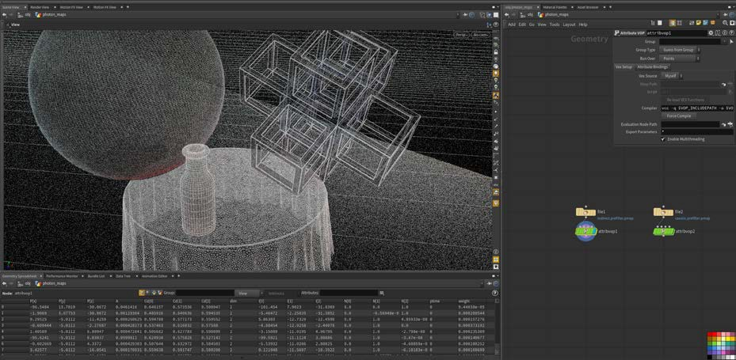
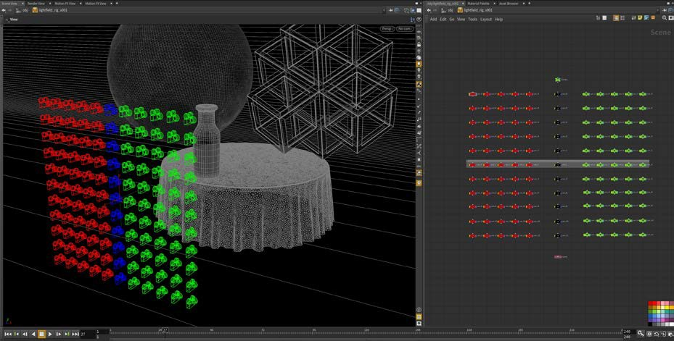
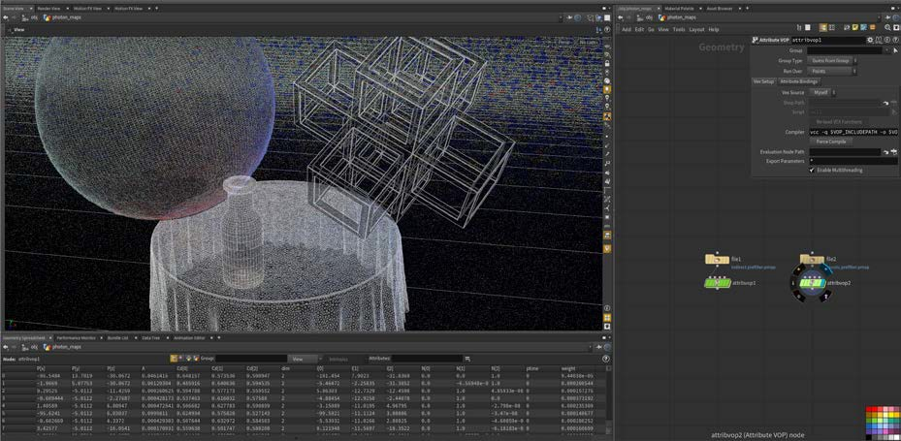
VOLUMETRIC VIDEO // PLENOPTIC LIGHTFIELD // POST PRODUCTION METHODOLOGIES

Slide 4
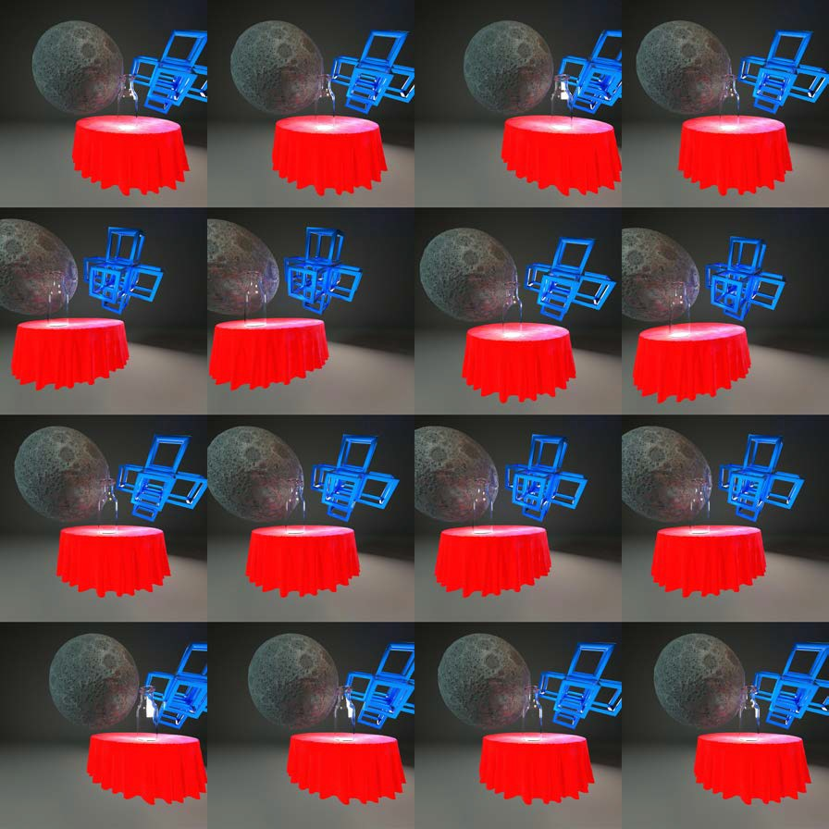
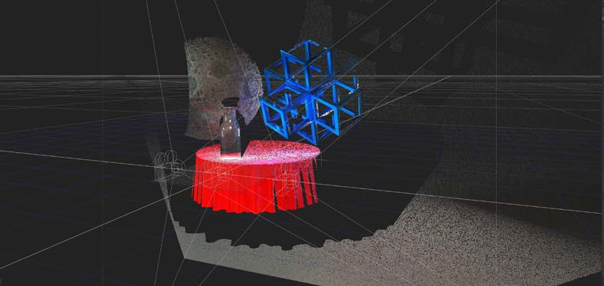
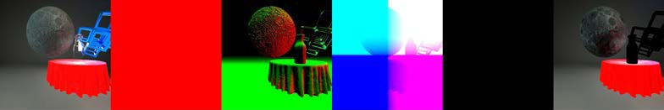
VOLUMETRIC VIDEO // PLENOPTIC LIGHTFIELD // POST PRODUCTION METHODOLOGIES

Slide 5
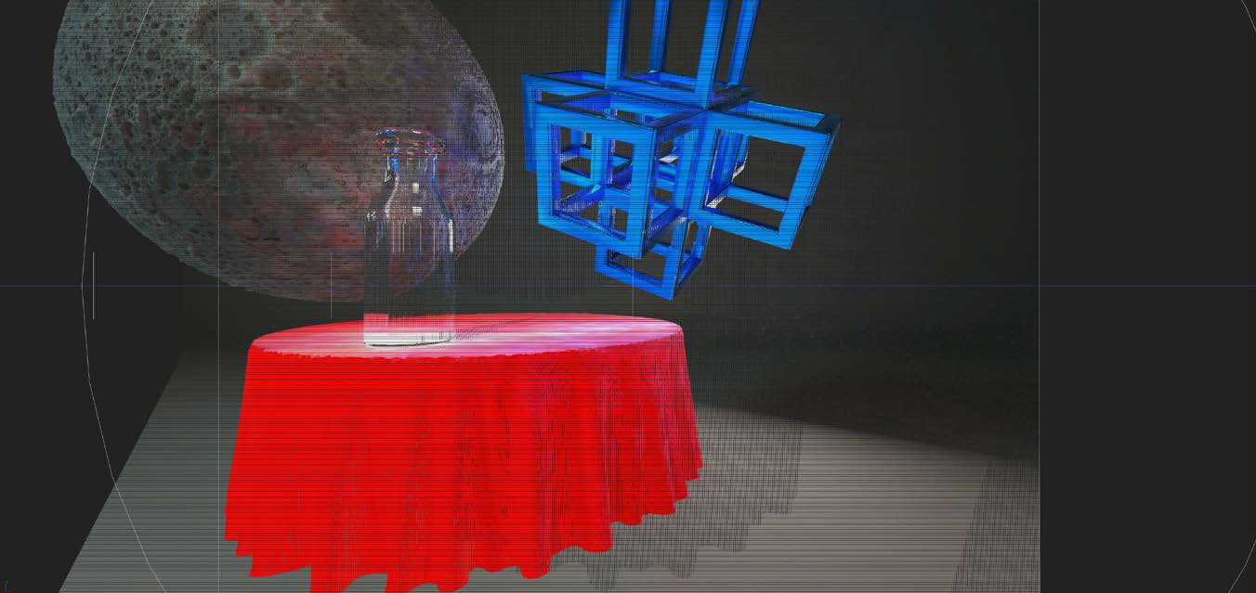
VOLUMETRIC VIDEO // PLENOPTIC LIGHTFIELD // POST PRODUCTION METHODOLOGIES
Lightfield, as we know it will never be other than a view dependent solution Combining Lightfield for volumetric reconstruction
Specular/Reflection information based off per camera calculations View Dependent

Slide 6
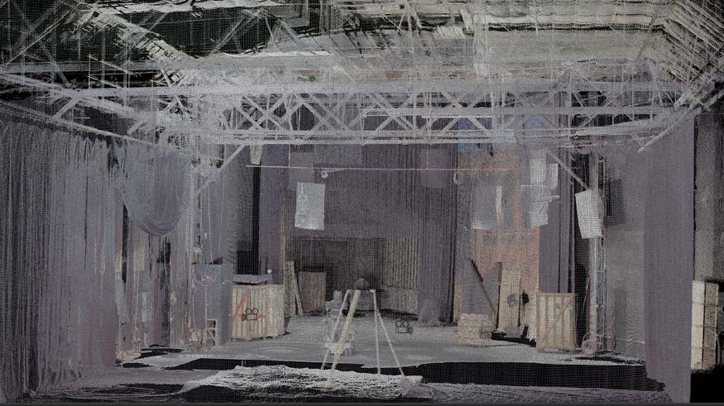
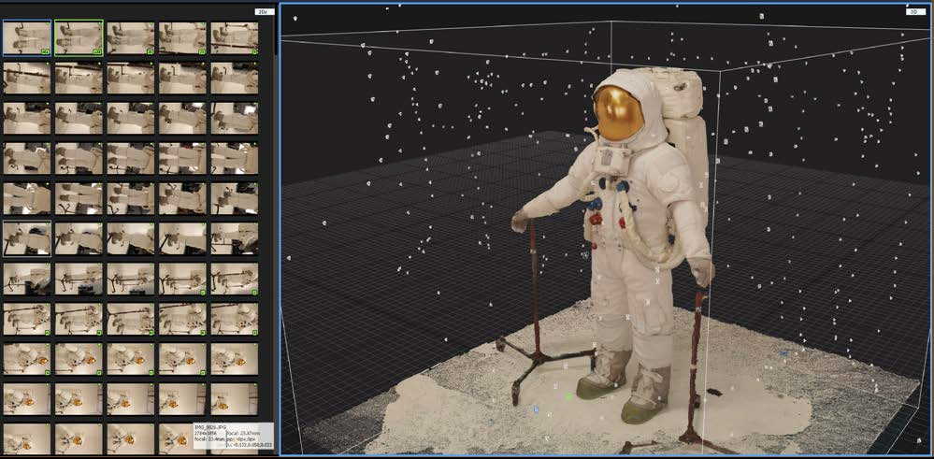
GEOMETRY RE-CONSTRUCTION // LIDAR DATA // PHOTOGRAMMETRY
Geometry reconstruction techniques Filling in missing or incomplete data Photogrammetry for object re-construction

Slide 7
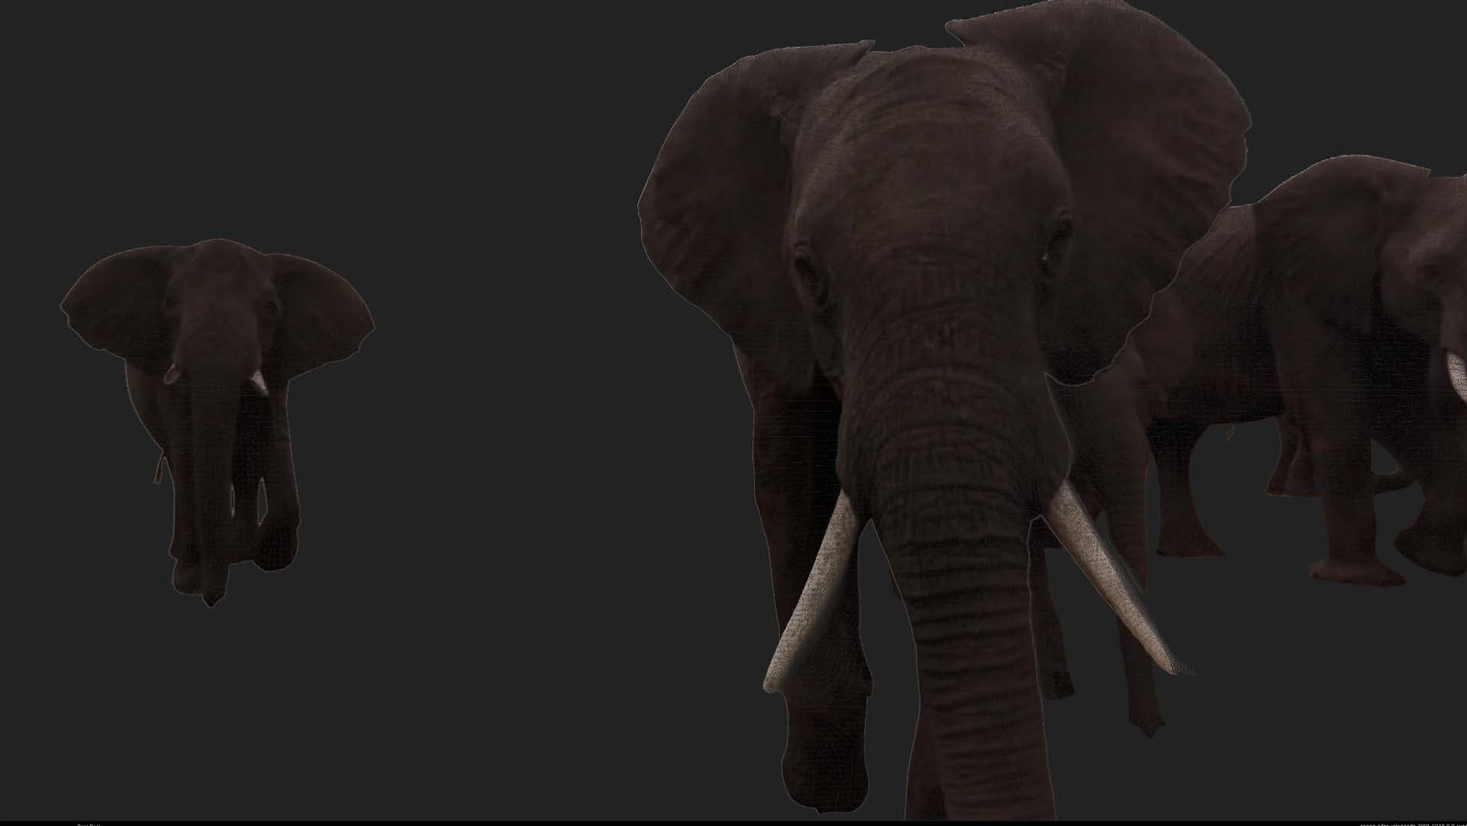
GOOGLE JUMP PROGRAM // VOLUMETRIC RECONSTRUCTION // POST PRODUCTION METHODOLOGIES
Pro:
Automatic stitching through the cloud
Stitched media delivered as 8K top/bottom stereo Stereo depth maps
CGI can be integrated easily in a variety of ways Can be turned into a room scale experience Can be integrated into the game engine
Any CGI post effects can be rendered easily without the need for elaborate camera set-ups Playback is not view dependent
Con:
Lighting is baked ( More on this later....) Can create large data sets
Currently data is 8 bit
Depth information needs refining through post production

Slide 8
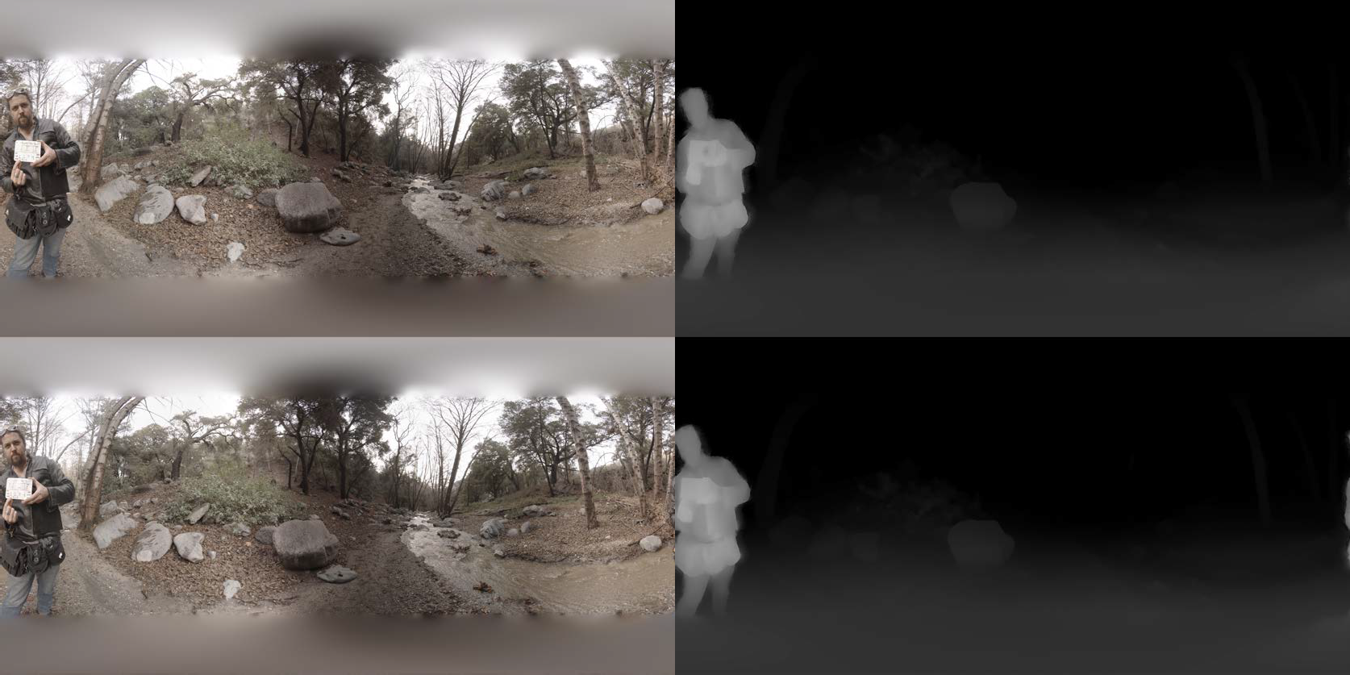
GOOGLE JUMP PROGRAM // VOLUMETRIC RECONSTRUCTION // POST PRODUCTION METHODOLOGIES
Top/Bottom stereo Nadir fixes
Depth clean up

Slide 9
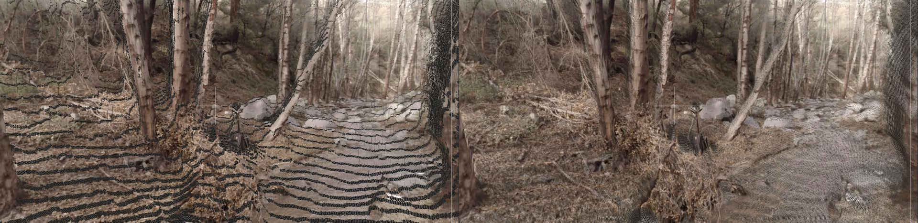
GOOGLE JUMP PROGRAM // VOLUMETRIC RECONSTRUCTION // POST PRODUCTION METHODOLOGIES
Volumetric reconstruction pre-processed and post-processed.

Slide 10
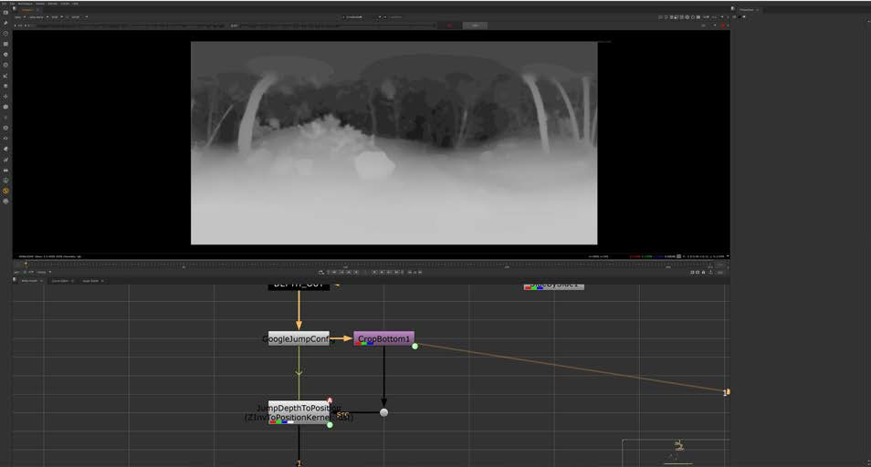
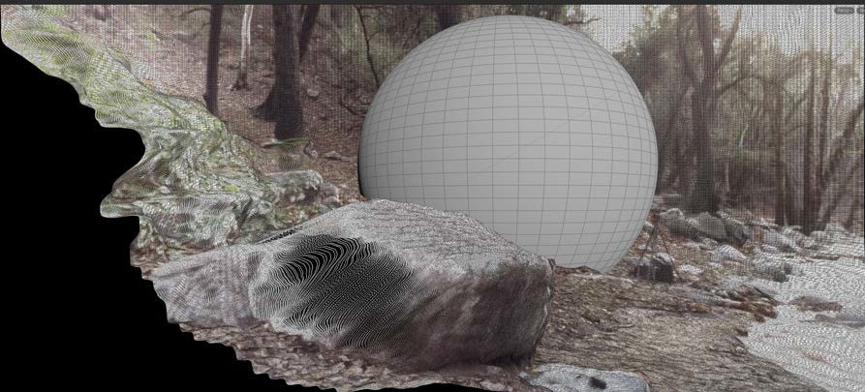
GOOGLE JUMP PROGRAM // VOLUMETRIC RECONSTRUCTION // POST PRODUCTION METHODOLOGIES
Over corrected right eye depth map
A sphere integrated with the volumetric video

Slide 11
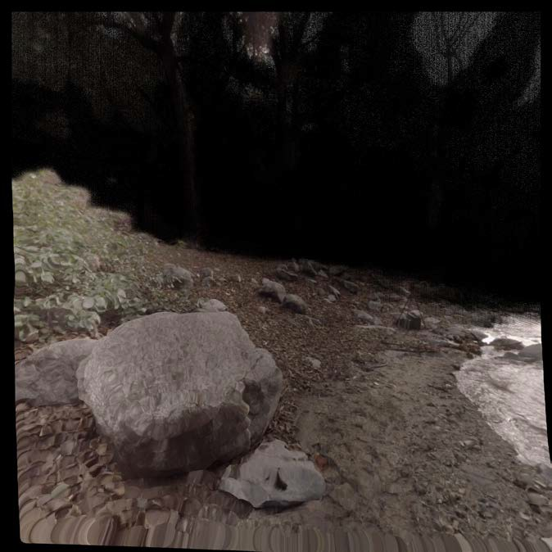
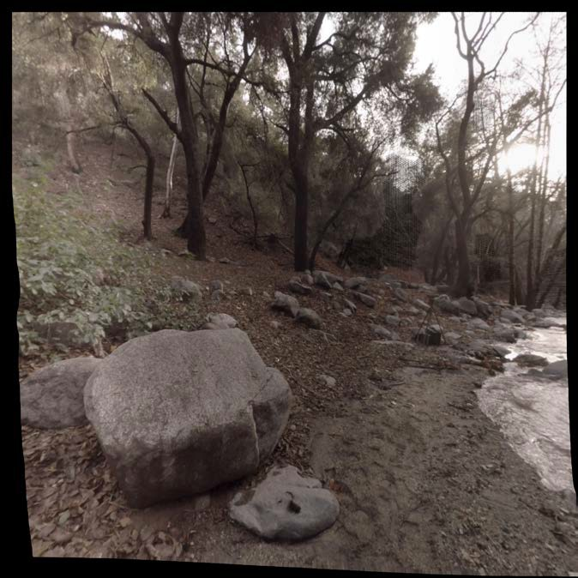
GOOGLE JUMP PROGRAM // VOLUMETRIC RECONSTRUCTION // POST PRODUCTION METHODOLOGIES
Distance based scale correction
Can be embedded as an attribute on the data for playback

Slide 12
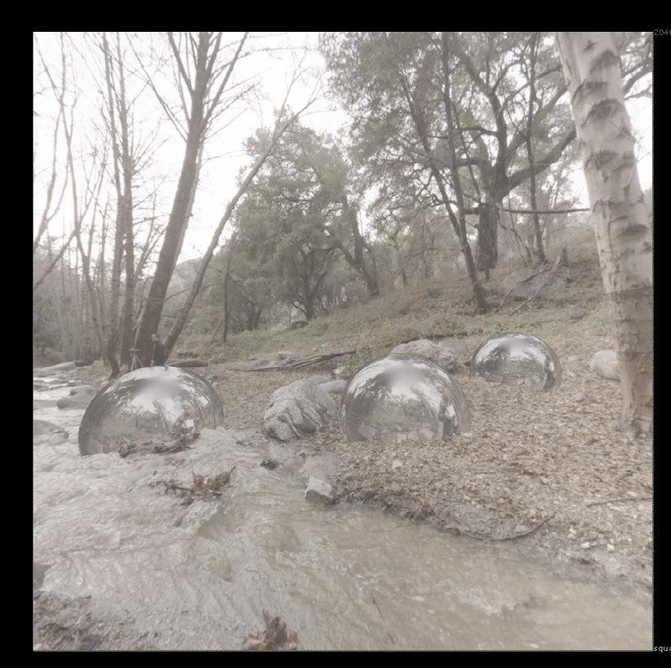
INTEGRATED CGI // DEEP BASED COMPOSITING
Deep based compositing techniques for cgi integration
Spatial rectification between the lat-long world and the cgi world Matching z-depth for correct stereo between cgi and shot lat long

Slide 13
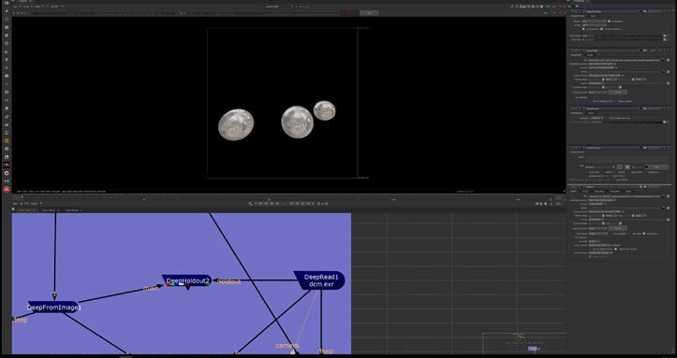
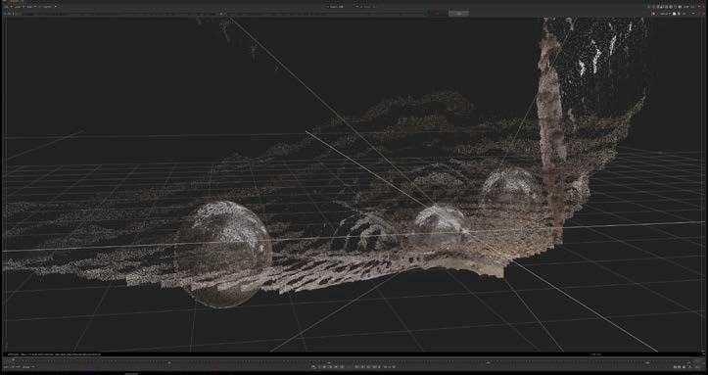
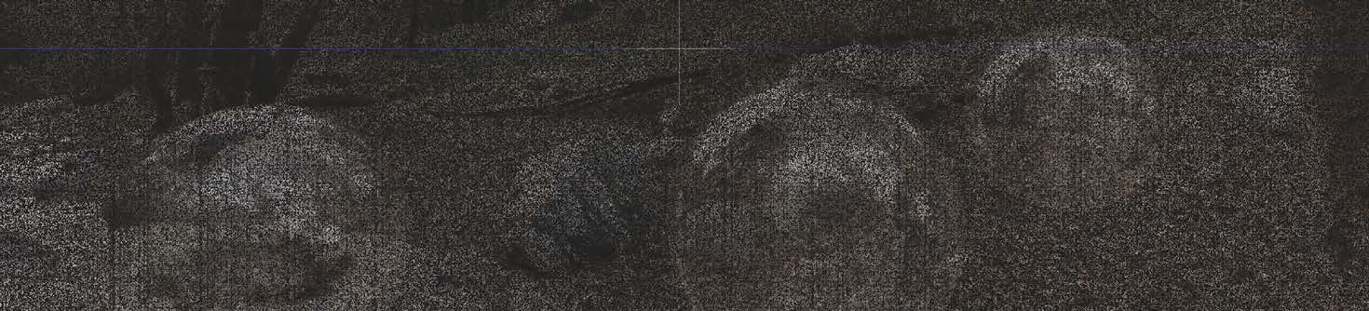
GOOGLE JUMP PROGRAM // VOLUMETRIC RECONSTRUCTION // POST PRODUCTION METHODOLOGIES
Deep re-construction in for CGI Integration

Slide 14
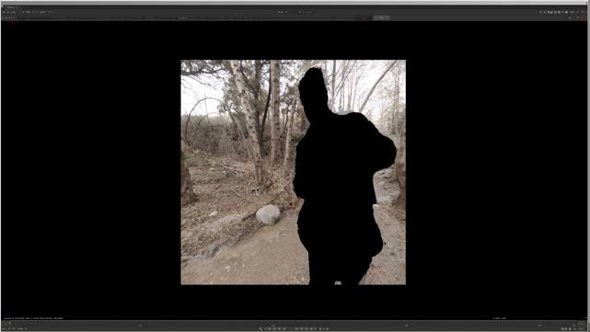
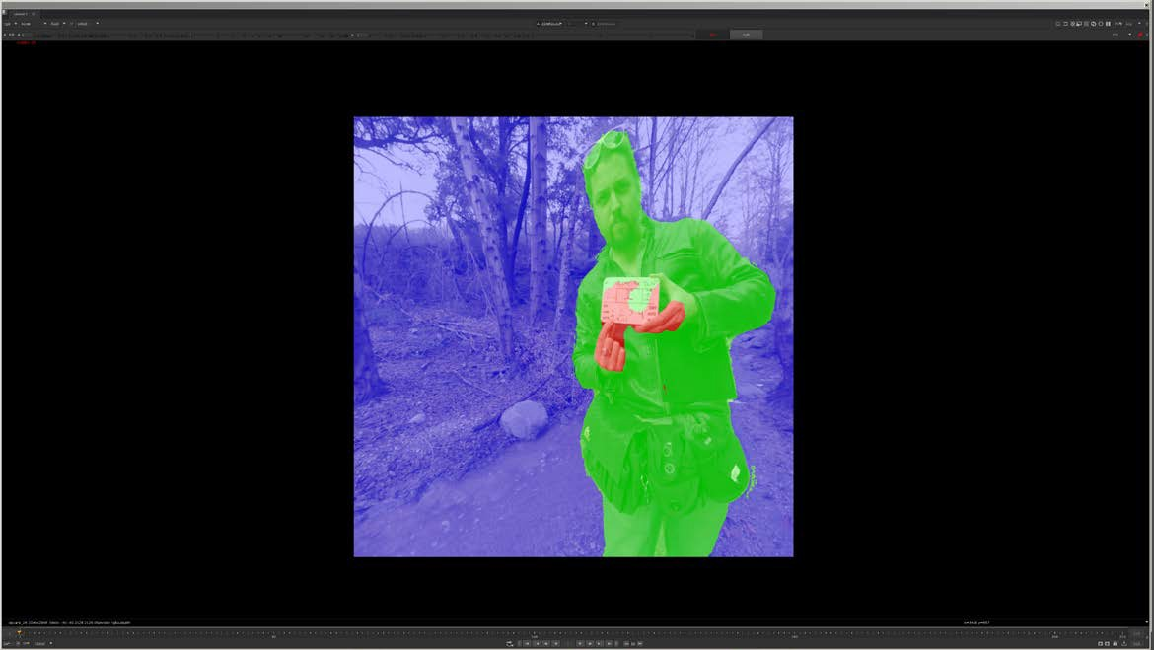
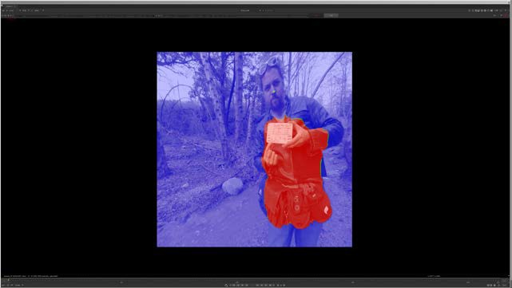
OBJECT EXTRACTION AND ISOLATION THROUGH DEPTH SLICING
Automatic z through depth data Altering depth of field
Re-lighting effects through normals

Slide 15
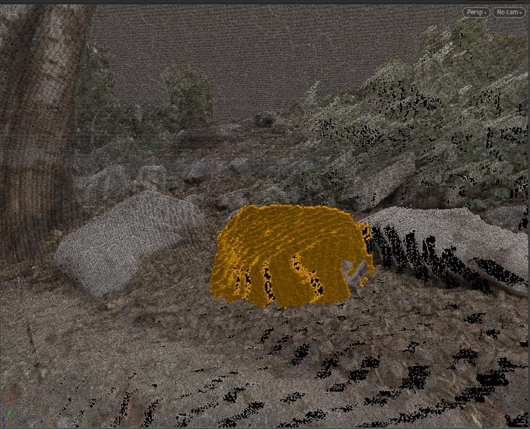
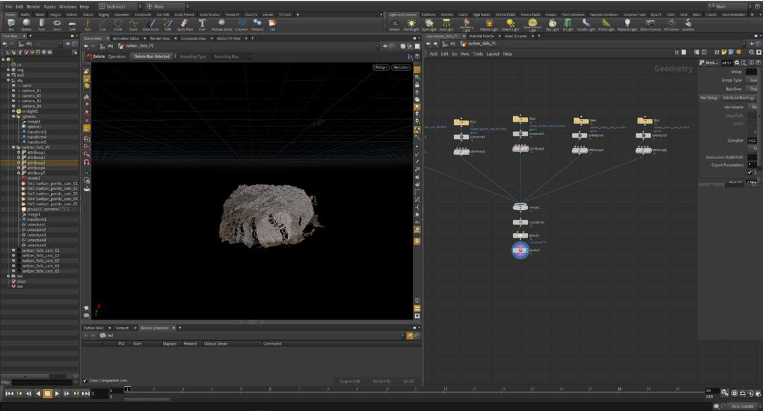
GEOMETRY RE-CONSTRUCTION THROUGH POINT CLOUD MESHING AND TEXTURE RE-PROJECTION
Using the data for geometry isolation Using the data for geometry creation Texture projection

Slide 16
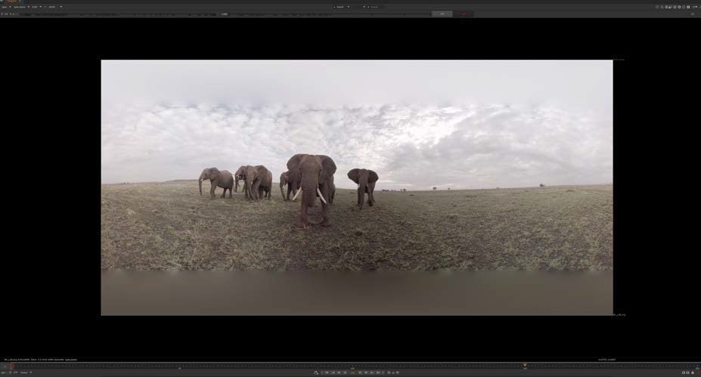
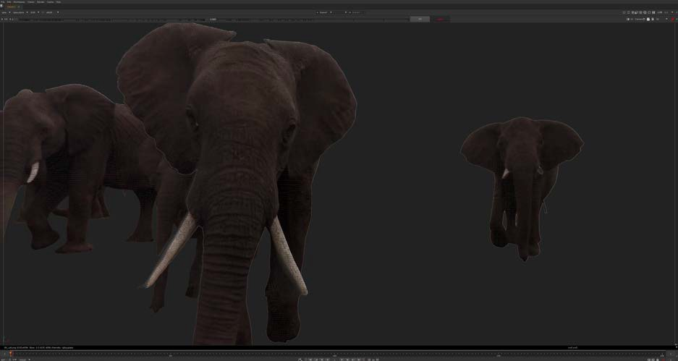
GOOGLE JUMP PROGRAM // VOLUMETRIC RECONSTRUCTION // POST PRODUCTION METHODOLOGIES
CGI Integration with Stereo footage from the Google Jump program

Slide 17
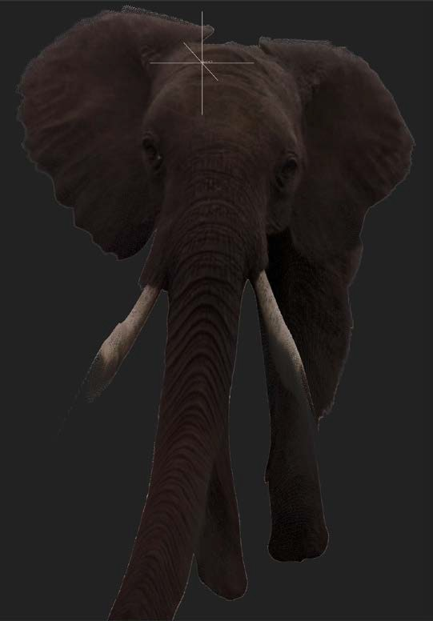
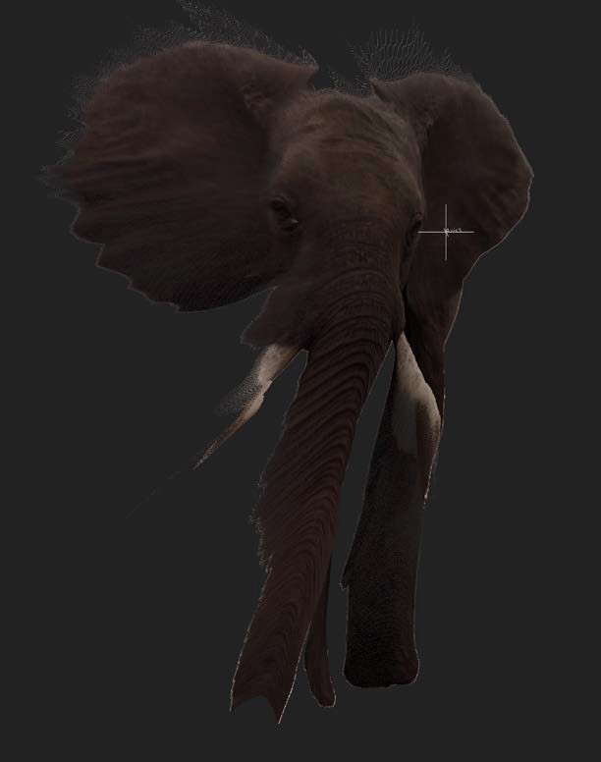
GOOGLE JUMP PROGRAM // VOLUMETRIC RECONSTRUCTION // POST PRODUCTION METHODOLOGIES
Object isolation for integration with CGI

Slide 18
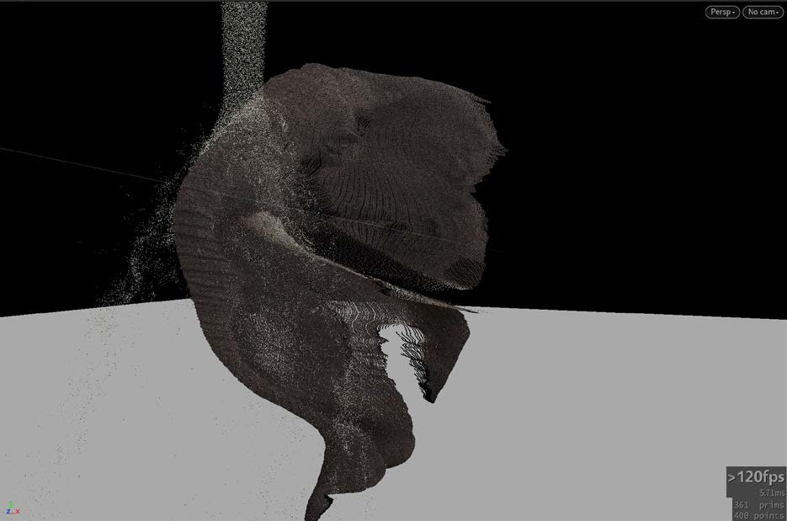
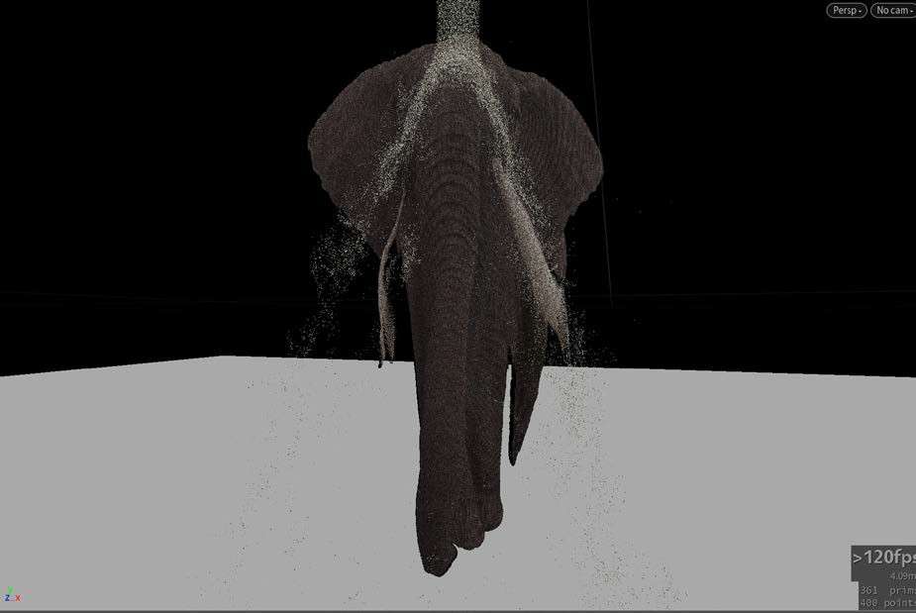
GOOGLE JUMP PROGRAM // VOLUMETRIC RECONSTRUCTION // POST PRODUCTION METHODOLOGIES
Fluid interaction with collisions

Slide 19
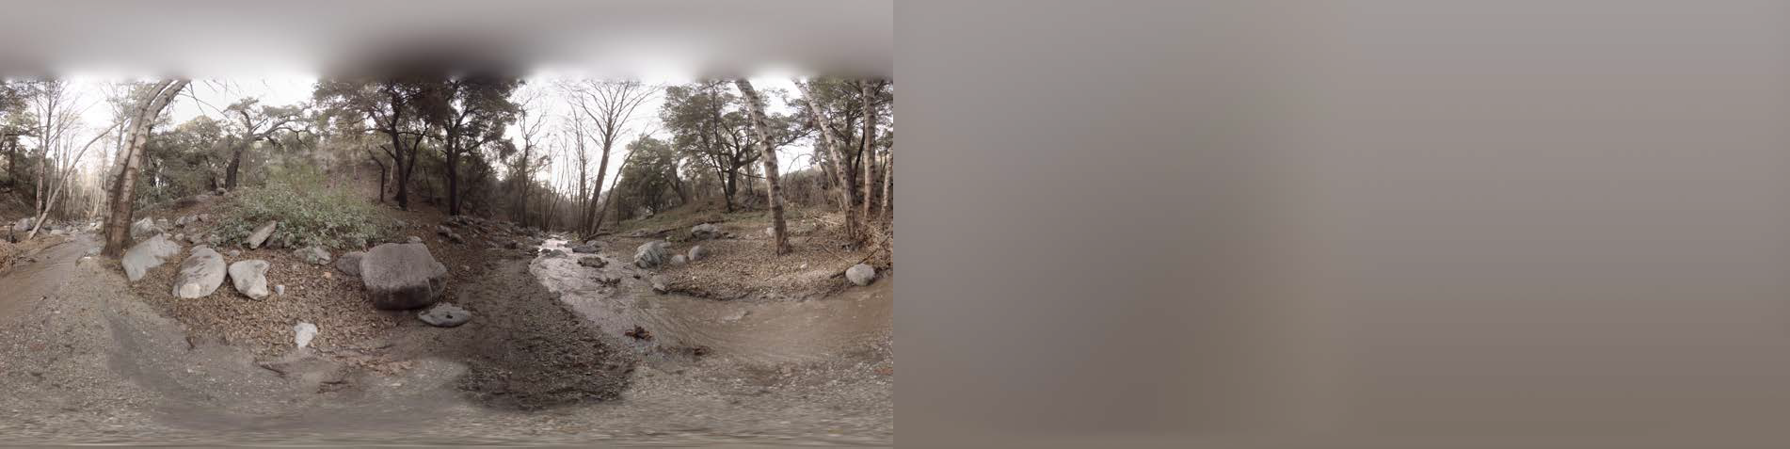
GOOGLE JUMP PROGRAM // VOLUMETRIC RECONSTRUCTION // DE-LIGHTING
Using the provided environment we are able to sample the diffuse lighting contribution With the provided lighting contribution we can project a ray on the data

Slide 20
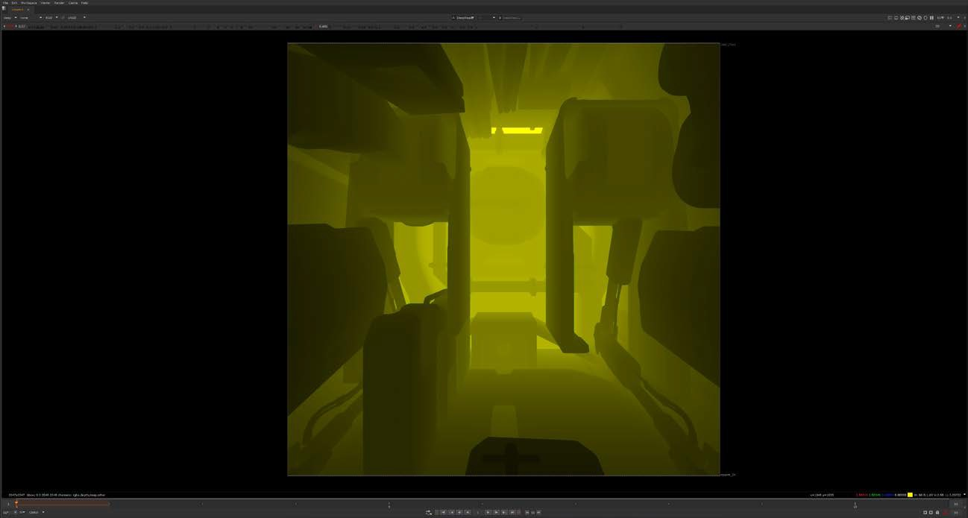
DEEP RENDERING // VOLUMETRIC RECONSTRUCTION // POST PRODUCTION METHODOLOGIES
Using deep renders for volumetric reconstruction Deep represents multiple float values per pixel

Slide 21
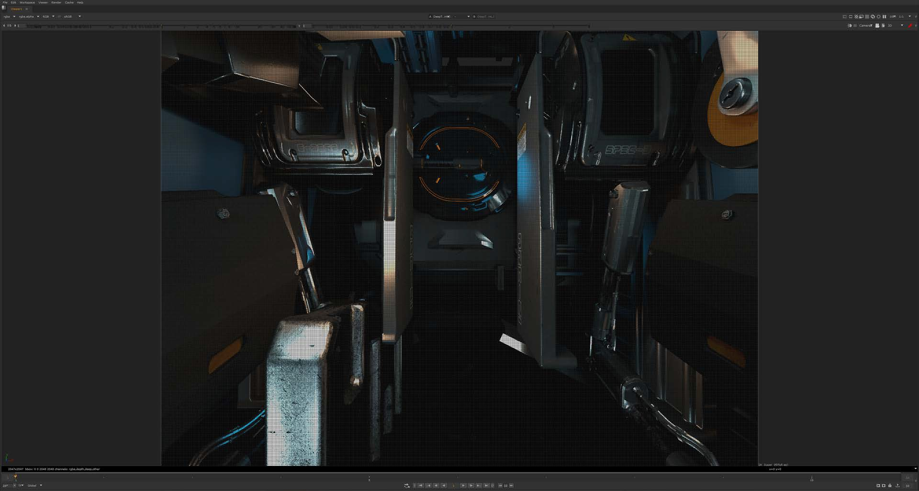
DEEP RENDERING // VOLUMETRIC RECONSTRUCTION // POST PRODUCTION METHODOLOGIES

Slide 22
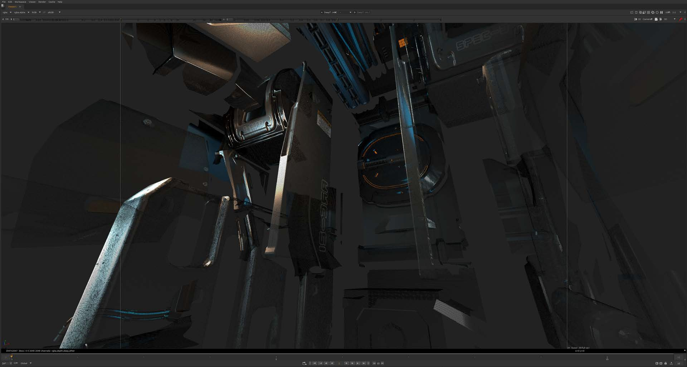
DEEP RENDERING // VOLUMETRIC RECONSTRUCTION // POST PRODUCTION METHODOLOGIES

