Slide 1


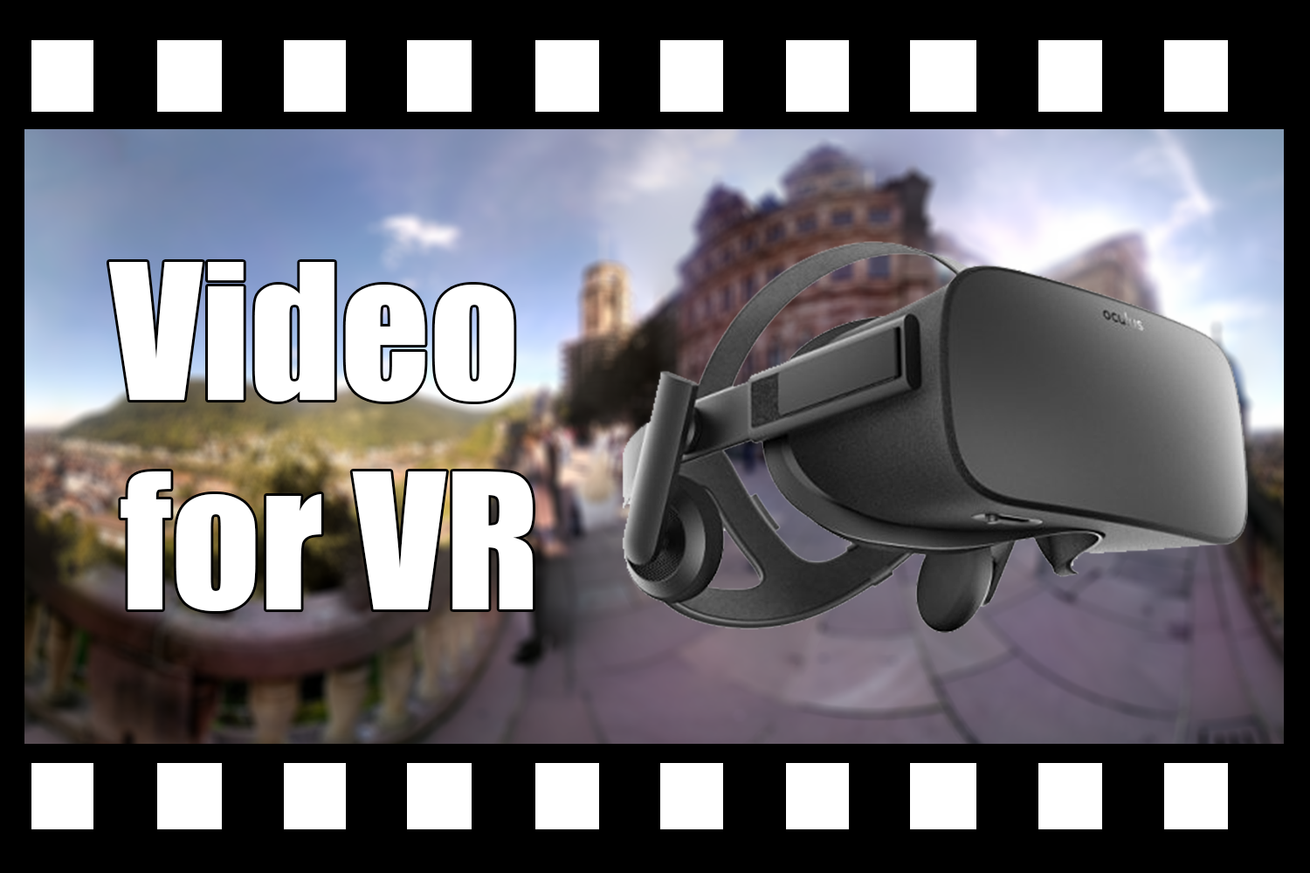

COURSES
Summary and Outlook
James Tompkin
Notes:
Thank you, Jordan. Well, it falls to me to conclude this course by providing a summary of what we’ve discussed, to provide an outlook on the near term, and to frame some of the challenges remaining.
We started the course with the idea that video for virtual reality produces a kind of perceptual teleportation, or telepresence. Video allows us to capture the real world and represent its dynamic appearance like no other technology. And virtual reality enables us to display visual content with unparalleled immersion.

Slide 2
COURSES
Summary and Outlook
James Tompkin
Notes:
We said that VR video depictions of the real world are sometimes so compelling because they can put you in someone else’s shoes, to experience something you may have no concept of, or to experience a new place or a new situation. VR video has broad impact across functional things like teleoperation and virtual tourism, but also across creative endeavors like art and storytelling.
To explore these ideas, we walked through three presentation formats of increasing complexity, but also which increasingly satisfy the perceptual needs of virtual reality.

Slide 3


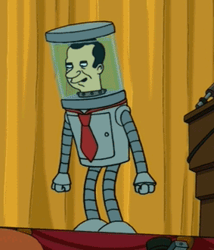
How did we get here?
360 video
Stereo 360 video
Light field video
Notes:
We started with 360 video, which lets you look in any direction, but is only monocular.
<ADVANCE>
Then we looked at stereo 360 video, where we have a video stream for each eye.
<ADVANCE>
And then we looked at what you might call light field video, where the restriction on your head being in a fixed place is removed, and this allows us to see parallax effects.

Slide 4
How did we get here?
Technical foundations:
  360 video: getting easier to capture, edit, distribute.
[https://code.facebook.com/posts/1126354007399553/next-generation-video-encoding-techniques-for-360-video-and-vr/]
Notes:
For 360 video, while there remain some technical challenges, in general the format is becoming easier to work with.
Oliver Wang explained to us how the capture, edit, and distribution tools are now getting good enough to be usable by non-experts.
https://code.facebook.com/posts/1126354007399553/next-generation-video-encoding-techniques-for-360-video-and-vr/

Slide 5
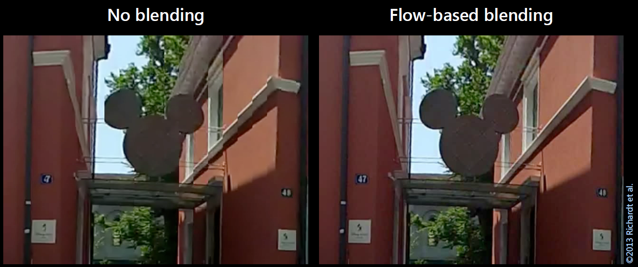

How did we get here?
Technical foundations:
  360 video: getting easier to capture, edit, distribute.
  Stereo 3D video and panoramas panoramas.
Notes:
To remove the ‘flatness’ of regular 360 video, Christian Richardt then described the principles behind stereo vision and stereo video, and how we can offset the center of projection to generate binocular effects. Many of the current stitching algorithms use optical flow to counter the parallax offset and reduce ghosting.

Slide 6
How did we get here?
Current practice:
  Art, storytelling, and tools to support creators
[Vremiere]
Notes:
Now, because these tools are getting easier to use, we are starting to be able to define the art of the medium, and Aaron Hertzman showed us how we are now looking at higher-level issues such as perception, establishing cinematographic rules, and issues around narrative.

Slide 7
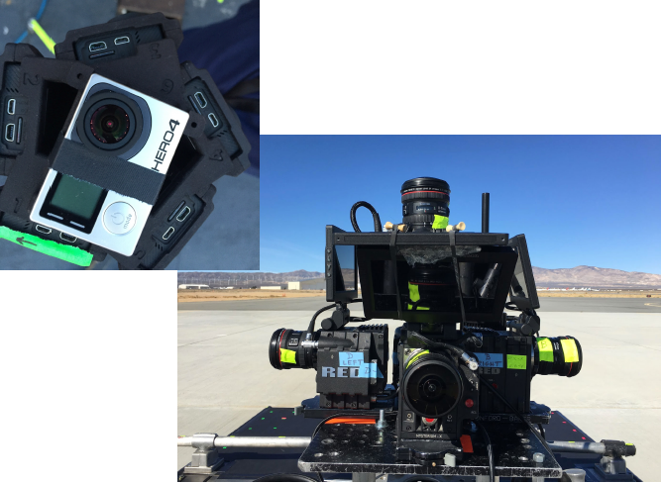
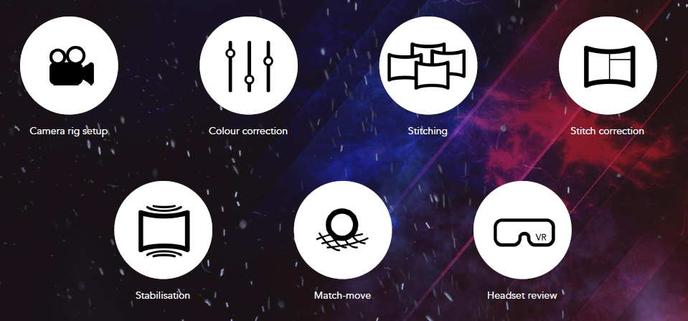

How did we get here?
Current practice:
  Art, storytelling, and tools to support creators
  Stereo 360 video production and post-production pipelines
Notes:
Jon Starck then told us about the practicalities of “filming with no borders”, as he put it, talking about current production rigs for monoscopic and stereoscopic 360 capture, plus the issues of stitching and depth that must be considered at capture time. He then continued to show us a set of tools in Nuke to fix issues in stereo 360 footage, like stitching the zenith and nadir.

Slide 8
How did we get here?
Cutting edge:
  Light field basics
y
θ,ɸ
z
x
Notes:
Moving beyond stereo 360 video to provide 6-degree-of-freedom experiences is a simple conceptual leap, but a huge technological leap. I began this section by describing how light field video requires large arrays of cameras, significant image processing for depth and point-cloud reconstruction, geometry and surface reconstruction algorithms, and real-time rendering techniques with time-varying geometry and texture.

Slide 9
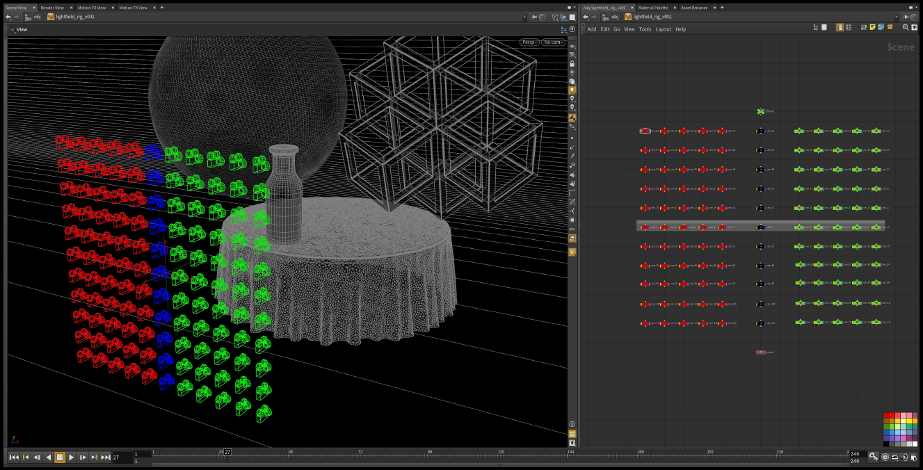
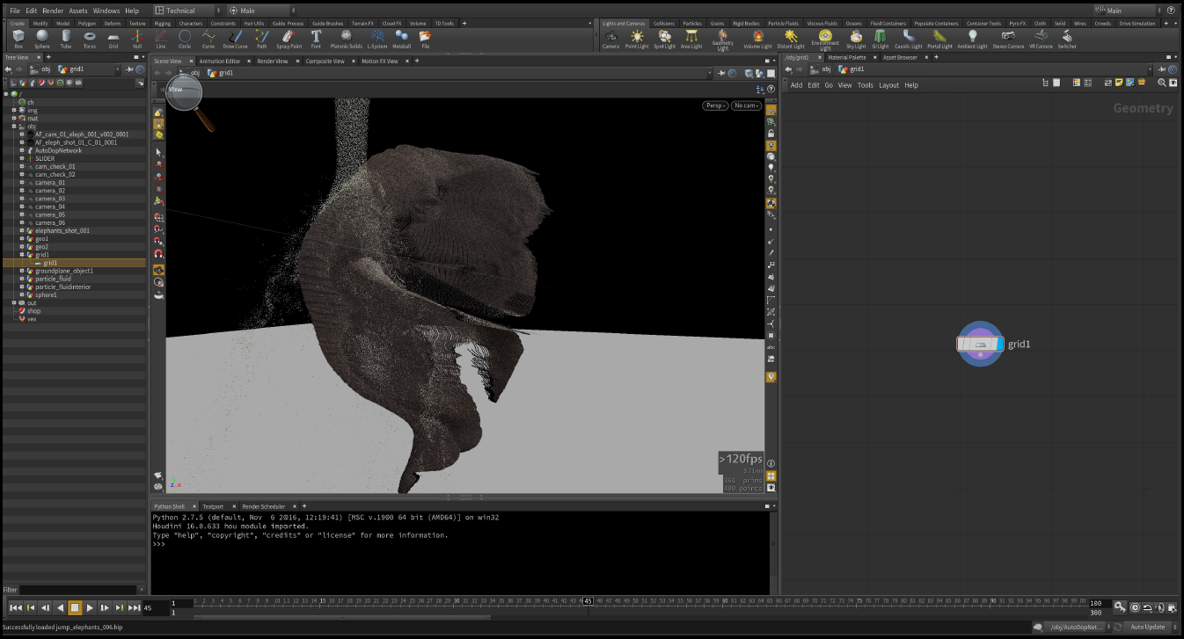
How did we get here?
Cutting edge:
  Light field basics
  Light field videos production
Notes:
Then, we just saw Jordan Halsey talk about light field video production, and how while it can give big immersion improvements, the way of working with the data is still really yet to be solidified. We also learned how even Google JUMP camera data can provide sufficient information to extract points clouds good enough for integration with CGI effects, like adding fluids which collide, plus provide lighting estimation.

Slide 10
Are we there yet?
Does VR video look and feel real?
  ‘Retina’ resolution = invisible pixels
Notes:
We have good capture resolution from our multi-camera arrays, but we have insufficient display resolution.
However, even if we did have the needed display resolution, there are other limiting factors, like the long processing times to generate very high resolution content, and the large distribution bandwidth required.
How will we distribute 6DoF content if it requires Terabytes? Maybe short term we will have to go back to selling them on physical disks?

Slide 11
Are we there yet?
Does VR video look and feel real?
  ‘Retina’ resolution = invisible pixels
  Binocular stereo with no perceptual mismatches
Notes:
Next, we need binocular stereo with no perceptual mismatches.
Right now, we can only achieve stereo for horizontal eye configurations, which causes ghosting and weird perceptual motions as the user tilts their head, or looks up or down, because the neck moves the eye positions.
There’s still some manual clean-up required for a lot of stereo footage.
We also haven’t solved the accommodation/vergence problem with this kind of stereo footage.
However, 6DoF material can help with solving these problems by more fully reproducing the original light field.

Slide 12
Are we there yet?
Does VR video look and feel real?
  ‘Retina’ resolution = invisible pixels
  Binocular stereo with no perceptual mismatches
  High dynamic range (HDR)
Notes:
Good progress in HDR sensors…we have cameras with high-bitdepth sensors that can see 10-stops.
We have HDR displays now; however, as far as I know, there are no HDR HMDs available.

Slide 13
Are we there yet?
Does VR video look and feel real?
  ‘Retina’ resolution = invisible pixels
  Binocular stereo with no perceptual mismatches
  High dynamic range (HDR)
  High frame rate (90 Hz+)
Notes:
Right now, high-end cameras like the Jaunt have 120 Hz capture from the camera, which isn’t quite fast enough for VR.
We also need to achieve fast rendering.
But high res. high framerate video can still be taxing to display, for instance, live streaming a multi-camera system = multi-GPU effort. <NVIDIA 8-camera 360 stereo system needs two GPUs to decode the streams and stitch in real time.>
When we consider 6DoF video, then for rendering we’re back to a classic real-time graphics trade-off. The render speed depends on scene complexity.

Slide 14
Are we there yet?
Does VR video look and feel real?
  ‘Retina’ resolution = invisible pixels
  Binocular stereo with no perceptual mismatches
  High dynamic range (HDR)
  High frame rate (90 Hz+)
  6 degrees-of-freedom (6DoF) capture + display
Notes:
On the display side, one of the major limitations used to be 6DoF tracking, but there has been great progress here – perhaps the largest of all of these issues.
Indoor outside-in solutions, e,g., Oculus, HTC Vive
Indoor inside-out solutions, e.g., HoloLens (tracking)
Indoor mobile – promising, e.g., Tango
Outdoors -> promising RGB camera solutions, e.g., ARKit

Slide 15
Are we there yet?
Does VR video look and feel real?
  ‘Retina’ resolution = invisible pixels
  Binocular stereo with no perceptual mismatches
  High dynamic range (HDR)
  High frame rate (90 Hz+)
  6 degrees-of-freedom (6DoF) capture + display
  Accurate object appearance: flawless geometry,
  view-dependent reflectance effects, e.g., mirrors, transparency
Notes:
Not perfect…
Getting better all the time.
Complex reflection is still hard.
Still too much manual work.
Physically-meaningful representations for surface reflectance and materials

Slide 16
Are we there yet?
A lot of data to capture, store, process, distribute.
  Limits effective resolution.
Editing!
  Consistent representations (exploit correspondence).
  Physically-meaningful representations (easier to edit).
    Especially materials and reflectance.
Consumer cameras and tools.

Slide 17

What about accommodation?
Focusable displays
Eye tracking +
depth of field rendering
Many neat display systems
on show at SIGGRAPH.

Slide 18




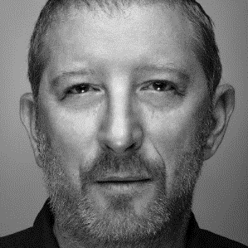






Q & A: Asking our team…
Aaron
Hertzmann
Oliver
Wang
Jon
Starck
Jordan
Halsey
Christian
Richardt
James
Tompkin
Notes:
OK, well, with that, we will transition to a Q & A.
But, before this, I would just like to say that we hope you have found the course engaging, and are as excited by the fantastic recent advances in video for VR as we are.
Personally, I would like to sincerely thank my co-instructors for presenting the course – their expertise and experience really helped to give a broad overview of many of the fundamentals, practices, and challenges within the discipline.
And, I invite you to give them a round of applause for their efforts.
So, onto questions.

Slide 19
What single thing would
most improve video for VR?
Notes:
To help things along, I asked my co-instructors a motivating question:
“What single thing would most improve video for VR?”
Now, little did they know, that I was secretly fishing for small, achievable research projects for my PhD students…

Slide 20
“High quality capture and
authoring for 6DoF.”
Aaron
Hertzmann
Notes:
Aaron was the first to reply, and he said that ‘high quality capture and authoring for 6DoF” experiences would most improve video for VR. Now, perhaps I should have specified what I meant by ‘single thing’, because this is a huge chunk of the space…
…but invariably this would drastically improve the quality of the medium, as well as improving comfort for the viewer by reducing sickness.

Slide 21
“Display technology is the big limitation now.
We need comfortable HMDs that have wide field of view, high pixel density, variable focus, and good tracking.”
Oliver
Wang
Notes:
Oliver then followed up by saying that, on top of 6DoF, the display technology is the big limitation now.
We haven’t touched upon this very much in our course, but the need is implicit. Oliver wants comfortable HMDs with a wide field of view, high pixel density, variable focus, and good tracking, where ‘good’ probably means ‘perfect’.
OK, well, thanks for that ‘single thing’ Oliver – I’ll just tell my PhD student that they should plan to study for 10 years.

Slide 22
“Putting the past two things together [will most improve VR video].
High-quality 360 degree environment (video) capture, processing and display in 6DoF with light field displays.”
Christian
Richardt
Notes:
Christian then said that, what will most improve VR video, what is really needed, is the combination of these past two things.
“High-quality 360 degree environment video capture and processing, plus display in 6DoF with light field displays.”
Jon took a slightly different approach.

Slide 23

“6DoF cats.”
Jon
Starck
www.catsandvr.com
Notes:
6DoF cats.
But, unfortunately, Jon is behind the times, because he doesn’t know about Cats and VR.com – the future iz meow.

Slide 24
“’Content is king’ – content drives adoption.
‘Wow factor’ needs a huge budget.
Complexity and cost to create high-quality content is the real barrier.
We need simple accessible tools to experiment and create VR video,
with a platform to deliver it.”
Jon
Starck
Notes:
Our experience is that "content is king" - high quality content always drives adoption. There so often seems to be tech for the sake of tech, but there needs to be compelling content for you to put on a headset and immerse yourself in VR.
What stops this now? - the complexity and cost to create high-quality content. There is a lot of interesting experimentation in the VR space, but it takes a big budget to produce something with a wow factor. The Google Spotlight Stories "Help!" had a *huge* budget.
So I would add: simple, accessible tools to experiment and create content, with a platform to deliver content.
This is why Cardboard was great for 360 video as it was readily accessible platform and it will be interesting to see how much Daydream drives adoption.

Slide 25
“There is a perpetual argument about the type of content appropriate for VR.
What's clear is that VR makes sense for experiential content. Better tech (displays, 6DoF) will make it ‘as if you were there’.”
Jon
Starck
Notes:
There seems to be an ever ongoing argument about the type of content that is appropriate for VR.
What's clear though is that VR makes sense for experiential content and that is where better tech (displays, 6dof) will make it a more compelling experience "as if you were there“ – being somewhere else you otherwise couldn’t be, being in an event you otherwise wouldn’t be a part of, transported to another place.

Slide 26
“I still wonder though…
…even if there is high quality 360 content, with high quality displays and full 6DoF support…
What will make people put on
a headset at home?”
Jon
Starck
Notes:
... I still wonder though, what will make people want to put on a headset at home even if there is high quality 360 content, with high quality displays and full 6dof support?
Is experiential content sufficient?
Jon is still skeptical.
But, he understands that it’s still early days – a new type of medium.

Slide 27
“Better information extraction from imagery.
32-bit+ depth, planar+ surfaces, SV-BSDFs…
Everything for physically-based rendering.
Integrate modalities to help (lidar + video).
Machine vision for surface recognition to
fill in what we can’t sample.”
Jordan
Halsey
Notes:
Better information extraction from imagery.
Whether it is better depth calculations in a higher bit depth. better resolution of planar surfaces in depth, better tools for measuring the SV-BRDF and materiality through imagery. It would be cool if somehow through machine vision we could do surface recognition and create float maps that could correspond to the various PBR values, ior, roughness, reflectance, etc. I think things along this line will help to make better immersive experiences through a variety of mediums.
BSDF = BRDF + BTDF (reflectance + transmission) = (scattering)
PBR = physically-based rendering
IOR = index of refraction
Point cloud compression for streaming
Better tools for when you have various datasets, like if you could take the measurements from lidar to aid in the depth calculations for video captured in the same environment.

Slide 28
“People on mass will put on headsets when they look good, are untethered, and can function as AR glasses.
Everything is preparation for that day.
Until then, it's Netscape in 1992.”
Jordan
Halsey
Notes:
People on mass will put on headsets when they look good, are untethered, and can function as AR glasses.
I believe everything is prep for that day.
Until then it's Netscape in 1992

Slide 29
Reducing sickness.
Live-streaming video = telecommunications.
VR video elements for augmented reality.
What sells? Sex and Sports.
James
Tompkin
Notes:
For my part, I’m going to explicitly mention something which is implicit in everything we’ve said so far, which is VR sickness. We don’t really have good ways to predict sickness, or know how much of the potential audience might suffer sickness for a piece of footage, which means that footage has to be user tested.
“Instant vomit really makes you pivot.” – Jorge Gutierrez (Son of Jaguar)
Live-streaming video = “Telecommunications.”
VR video for augmented reality – VR video objects integrated into viewer’s current environment
On the issue of compelling content, I’m going to suggest two things that definitely sell: “Sex and Sports.” For instance, I’ve always imagined a VR system for watching motorsports would be pretty compelling, where I can be in a Formula 1 car zooming round a track.

Slide 30
QUESTIONS For you
What depictions and experiences are best suited to VR?
  What kinds of experiences do you want?
  Where will experiences go next?
How would you convince mass market of strengths of medium?
How long until 6DoF will be cost effective?
Notes:
…but we’ll leave these for another course.

Slide 31
Q & A prompts:
COURSES
Aaron: “High quality capture and
authoring for 6DOF.”
Oliver: “Displays. Wide FOV, dense pixels,
variable focus, good tracking.”
Christian: “Only by combining these two.”
Jon: “Content is king; better content tools.”
Jordan: “Physically-based reconstruction.”
James: “Sickness. Sports. Streaming.”
Thank you!
http://richardt.name/pub/Video4VR/

