Slide 1

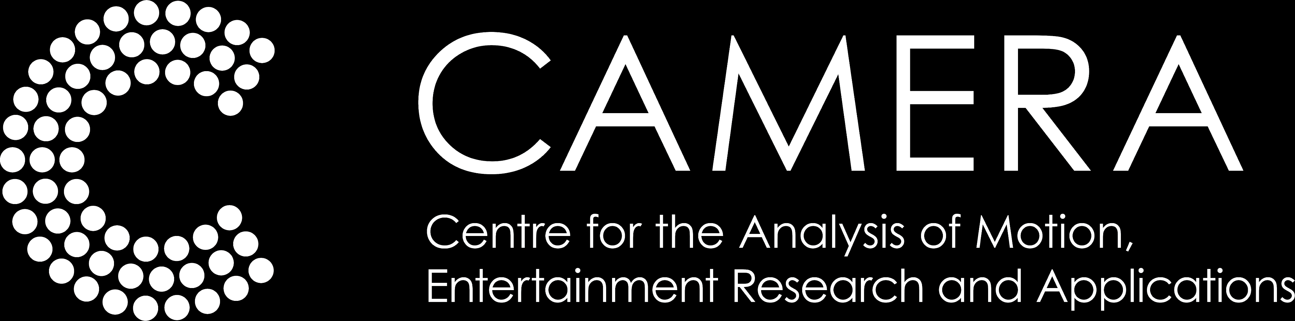

Stereoscopic 3D Videos and Panoramas
Christian Richardt
Notes:
<Introduction>
My name is Christian Richardt and I am an assistant professor at the University of Bath, in England, in the Centre for the Analysis of Motion, Entertainment Research and Applications, in short CAMERA.
Before we’re diving further into Virtual Reality in this course, I would like to spend some time to focus on the technology of stereoscopic 3D videos and panoramas, which are the foundation of 360 degree omnistereo video – the current state of the art in VR video.

Slide 2
Stereoscopic 3D videos and panoramas
Capturing and displaying stereo 3D videos
Viewing comfort considerations
Editing stereo 3D videos (research papers)
Creating stereo 3D panoramas
Notes:
In this part, I will be covering the following four topics:
The basis of stereoscopic 3D videos, and how to capture and display them.
Important considerations with respect to the viewing comfort of stereoscopic content.
A brief review of stereo 3D video editing techniques from the research literature.
How to create high-quality stereoscopic 3D panoramas.

Slide 3

Stereo camera rigs
Parallel
Converged (‘toed-in’)
Notes:
The core principles of stereoscopy were first described by Wheatstone in 1838.
Capturing stereoscopic 3D content can be as simple as putting two cameras side by side.
There are two main ways of doing that: @ having parallel cameras, or converged cameras.
Parallel cameras @ are generally the best choice, as they cause the least amount of headaches.
Converged cameras are ‘toed-in’ on an object of interest, which increases the shared field of view, but causes a range of headaches for subsequent editing and display.
Explanation explanation from Zilly et al., Proc IEEE 2011:
“At first view, the toed-in approach intuitively seems to be the more suitable solution because it directly fits to the convergence mechanism of the HVS as shown in Fig. 1. However, it has been shown in the past that the parallel approach is nonetheless preferable, because it provides a higher stereoscopic image quality [15], [16]. With the toed-in configuration, there is a keystone distortion between the image planes of the capturing cameras and the corresponding images planes at the 3-D display surface [17]. This, in turn, induces both horizontal and (unwanted) vertical disparities, which are known to be one further potential source of eyestrain [18], [19]. In contrast, the parallel camera setup only creates the de- sired horizontal parallax that is required to reconstruct depth correctly at planostereoscopic devices. It also ensures the avoidance of the stereoscopic 3-D distortions that will be explained in more detail in Section IV-F.”

Slide 4
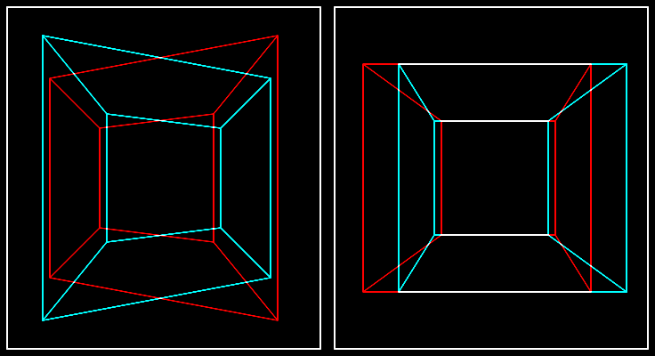
Stereo camera rigs
Parallel
Converged (‘toed-in’)
©2012 Oliver Kreylos
©2012 Oliver Kreylos
Notes:
Source:
http://doc-ok.org/?p=77

Slide 5
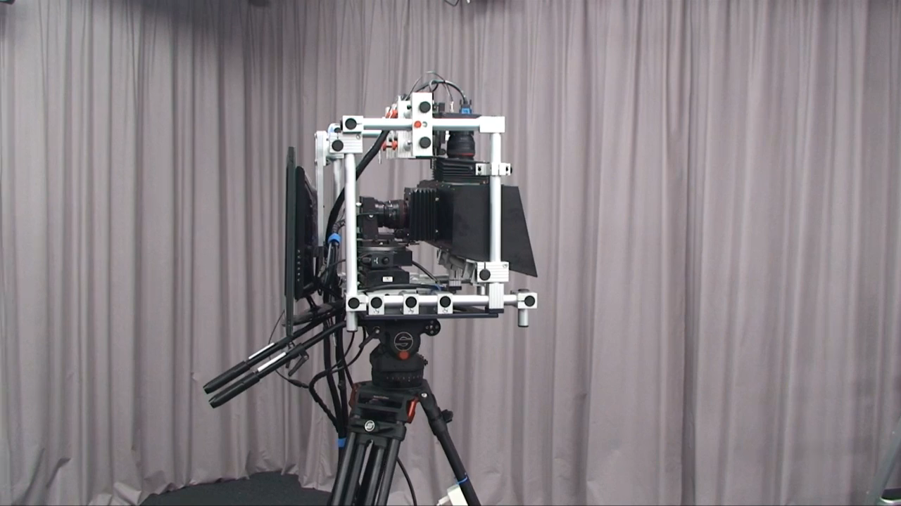
Computational stereo 3D camera system
©2011 Heinzle et al./ACM
Computational stereo camera system with programmable control loop
S. Heinzle, P. Greisen, D. Gallup, C. Chen, D. Saner, A. Smolic, A. Burg, W. Matusik & M. Gross
ACM Transactions on Graphics (SIGGRAPH), 2011, 30(4), 94:1–10
Notes:
Both parallel and converged stereo content is captured in practice, and to transition between them at will, Simon Heinzle and colleagues created a computational stereo camera system with movable and adjustable cameras behind a beam splitter.
Project website:
https://graphics.ethz.ch/publications/papers/paperHein11.php

Slide 6
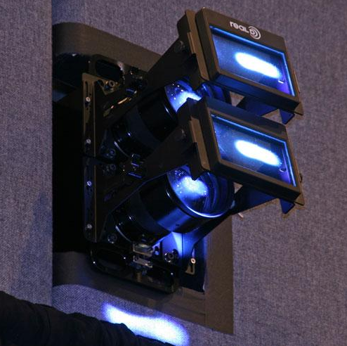
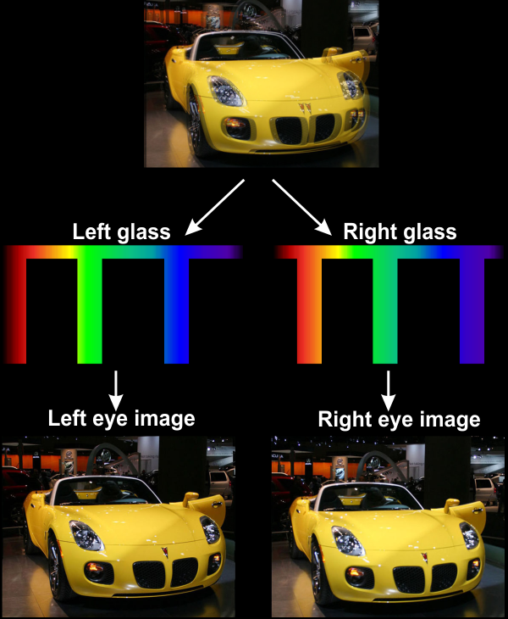
Commercial stereo 3D projection
Polarised projection
Wavelength multiplexing
e.g. RealD 3D, MasterImage 3D
e.g. Dolby 3D
©Raoul NK, 3dnatureguy/Wikimedia Commons/CC-BY-SA-3.0
©2011 Scott Wilkinson/Sound and Vision
Notes:
Perhaps the most widespread application of stereoscopic 3D video are 3D movies.
3D movies are projected mostly with commercial projectors, often based @ on polarised projection.
The two views for our left and right eyes are polarised differently, using a polarisation modulator as shown here, and special silver screen ensures that polarisation is reflected correctly.
Viewers then wear passive polarisation glasses, which filter out the correct view for each eye.
An alternative system by Dolby uses colour filters to split the visual spectrum of colours into two parts.
However, this system is not as widespread as polarised projection.
Sources:
https://www.soundandvision.com/content/content-theater
https://en.wikipedia.org/wiki/File:Dolby_3D.png (cropped)

Slide 7
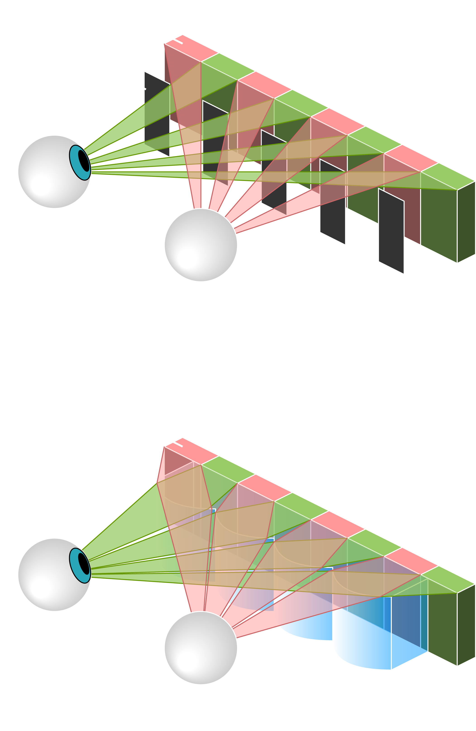
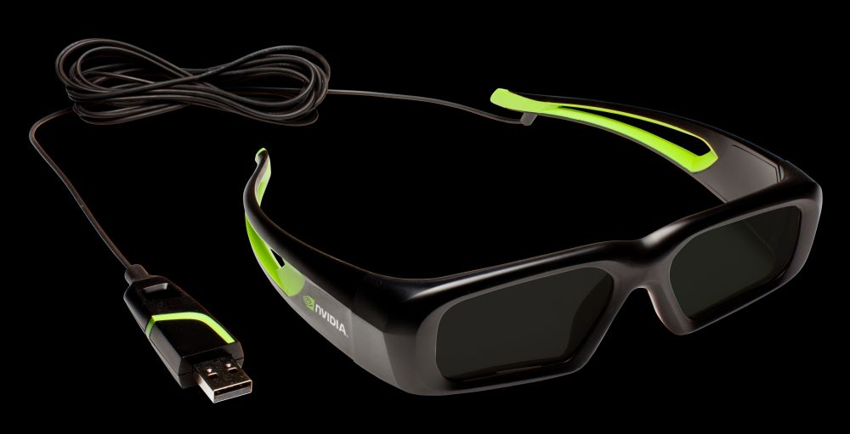
Medium-scale stereo 3D displays
Active shutter glasses
Autostereoscopy
e.g. NVIDIA 3D Vision, 3D TVs
©Cmglee/Wikimedia Commons/CC-BY-SA-3.0
©2011 MTBS3D/NVIDIA
Notes:
Sources:
http://www.mtbs3d.com/articles/news/12499-nvidia-releasing-wired-3d-glasses-99-a-pair
https://commons.wikimedia.org/wiki/File:Parallax_barrier_vs_lenticular_screen.svg (edited colours for display on black)

Slide 8
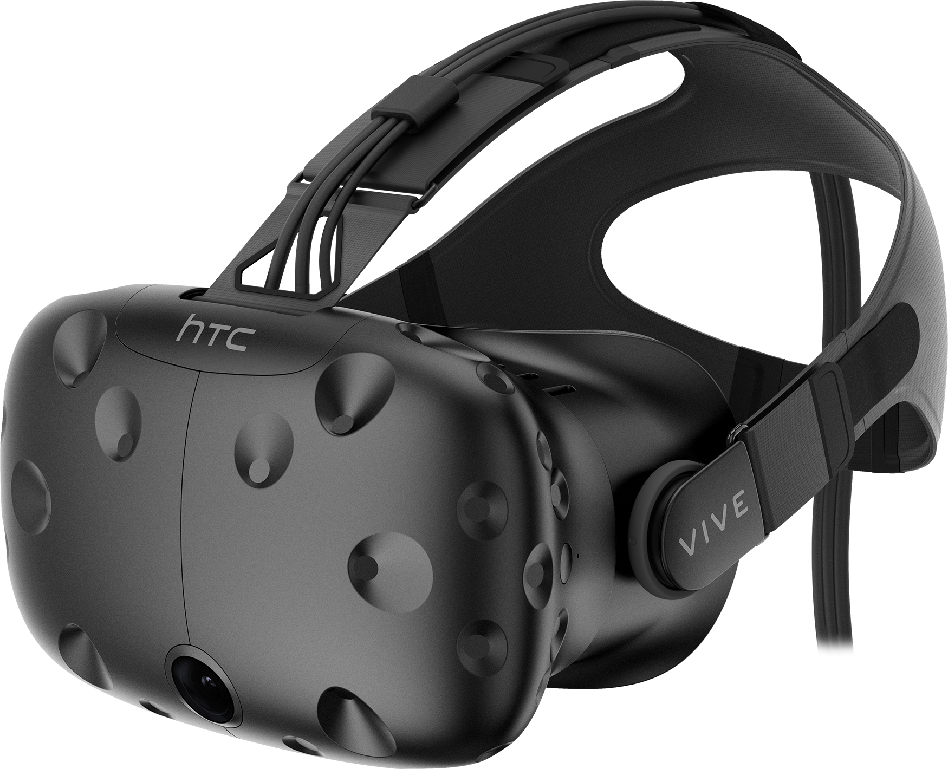
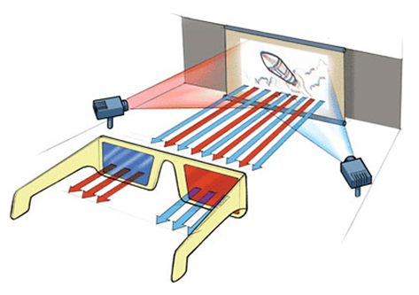
Other stereo 3D displays
Head-mounted displays (HMDs)
Anaglyph stereo
e.g. HTC Vive, Oculus Rift, Google Cardboard
e.g. red cyan glasses, ColorCode 3-D, Inficolor 3D
©2016 HTC Corporation
©2016 Taringa
Notes:
Sources:
https://www.htc.com/us/about/newsroom/htc-vive-press-kit/ » Vive Photos
http://www.taringa.net/posts/tv-peliculas-series/19657196/La-historia-del-cine-en-3-dimensiones-Como-se-hacen-las.html

Slide 9

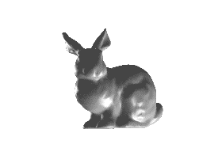
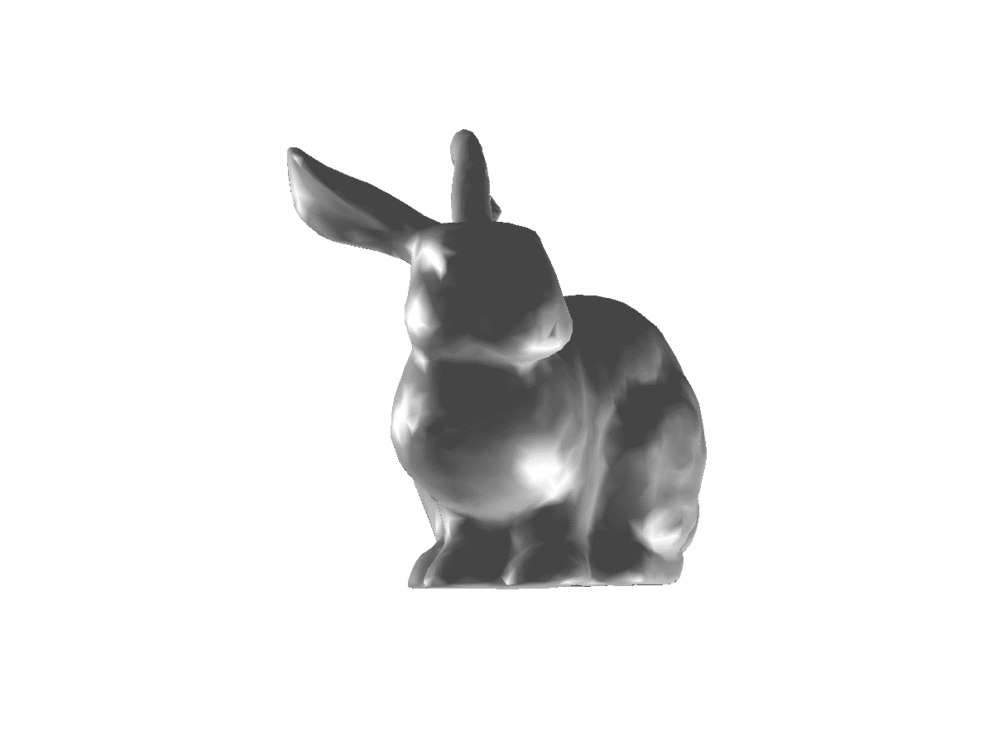
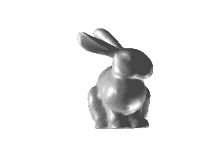
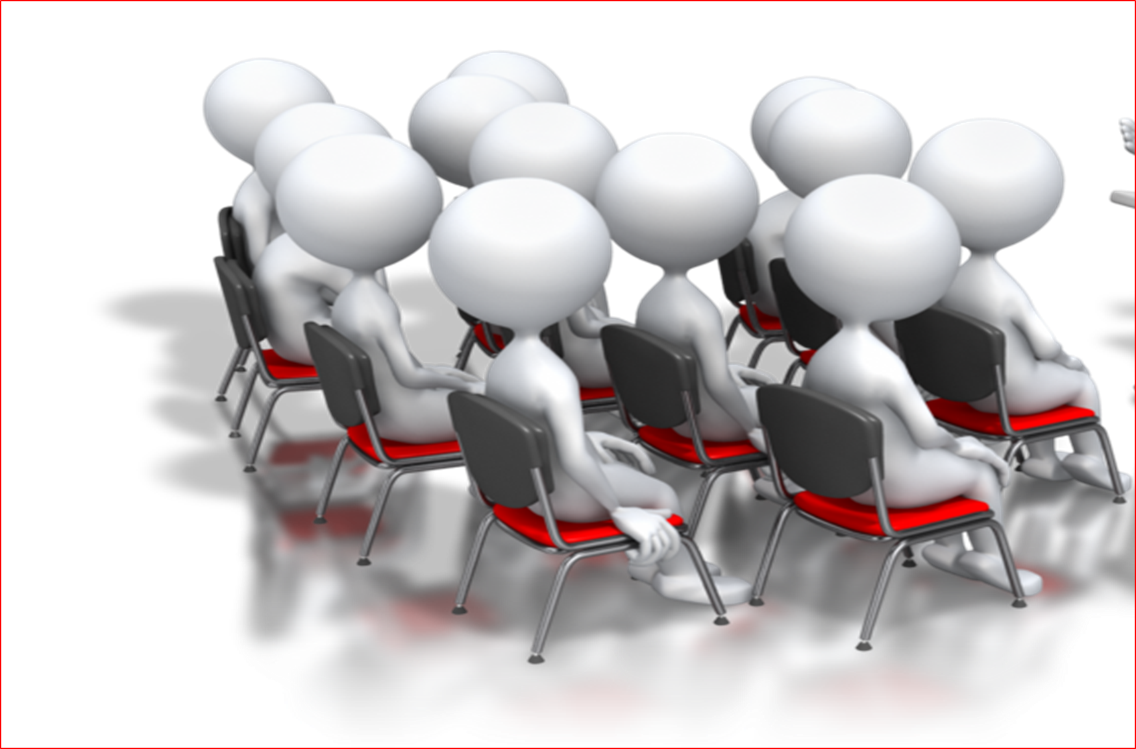
Cinema 3D
Narrow angular range that spans a single seat
©2016 Efrat et al.
Cinema 3D: large scale automultiscopic display
N. Efrat, P. Didyk, M. Foshey, W. Matusik & A. Levin
ACM Transactions on Graphics (SIGGRAPH), 2016, 35, 59:1–12
Notes:
Last year at SIGGRAPH, Netalee Efrat and colleagues presented a novel type of cinema-size projection system that provides a narrow angular range of views to any seat in the audience.
At this point, Cinema 3D is still a fairly theoretical setup with only a small-scale prototype, but future work is likely to make it more practical.
Project website:
http://www.wisdom.weizmann.ac.il/~netefrat/cinema3D/
Source:
http://www.wisdom.weizmann.ac.il/~netefrat/cinema3D/files/cinema3Dsiggraph_final.pptx (slide 11)

Slide 10
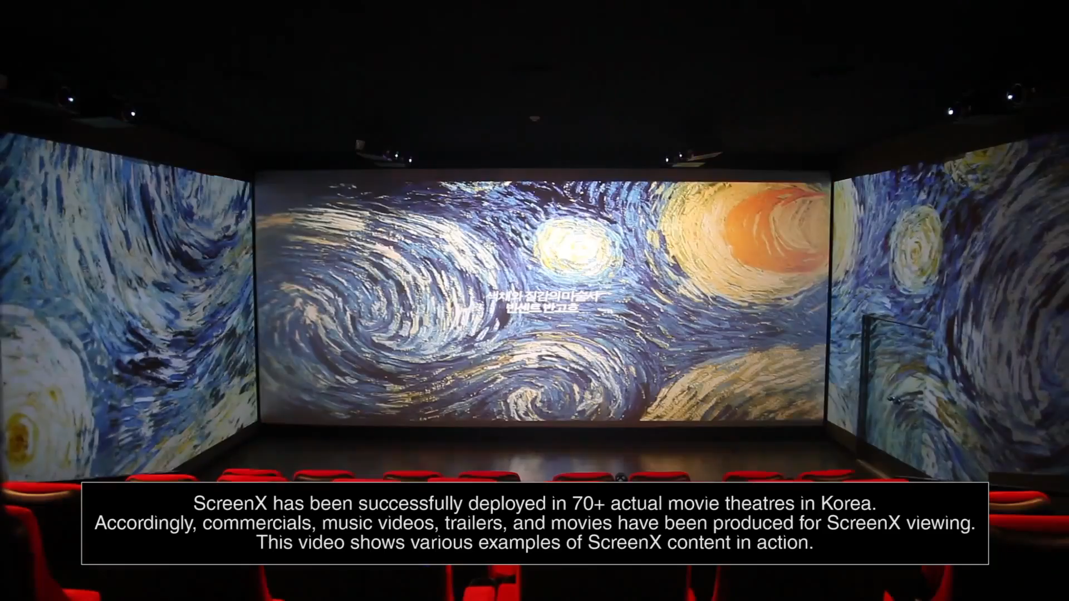
ScreenX
©2017 Lee et al./KAIST Visual Media Lab
ScreenX: public immersive theatres with uniform movie viewing experiences
J. Lee, S. Lee, Y. Kim & J. Noh
IEEE Transactions on Visualization and Computer Graphics, 2017, 23(2), 1124–1138
Notes:
ScreenX is a more practical, immersive projection system that uses additional projectors to also project on the walls of a cinema, as you can see here.
This system is deployed in more than 70 movie theatres in South Korea.
While stereoscopic 3D content is currently not supported, this setup is nonetheless more immersive, similar to large-scale IMAX projection domes.
Project website:
http://vml.kaist.ac.kr/publication/journal/2016/2016JungjinLee_TVCG.html
Source:
https://youtu.be/rKuuOAWhHcA?t=3m56s

Slide 11
Depth cues
Pictorial depth cues:
  size, occlusion, perspective,
  aerial perspective, texture
  gradient, motion parallax,
  depth of field, …
Ocular depth cues:
  Accommodation
  Vergence
Binocular disparity
Vergence
Accommodation
Slide courtesy of Petr Kellnhofer
Notes:
At this point, I would like to take a step back and take a quick look at how we as humans perceive depth.
The human visual system exploits multiple different types of depth cues and integrates all the evidence it observes.
Pictorial depth cues such as size, occlusion, perspective and so on are extracted directly from the images projected onto our retinas.
Ocular depth cues, on the other hand, are related to the muscles in and on our eyes, which influence the “focus setting” (known as accommodation), and angle between viewing vectors (vergence) of both eyes.
And finally, there is binocular disparity, which is the difference between the two images projected onto our retinas.
Source:
Kellnhofer et al.: Optimizing Disparity For Motion in Depth. EGSR 2013.
http://resources.mpi-inf.mpg.de/TemporalStereo/EGSR2013.pptx

Slide 12

How does disparity work?
Accommodation
(focal plane)
Screen
Object perceived in 3D
Object in right eye
Vergence
Viewing discomfort
Pixel disparity
Slide courtesy of Petr Kellnhofer
Object in left eye
Comfort zone
Depth
Notes:
Source:
Kellnhofer et al.: Optimizing Disparity For Motion in Depth. EGSR 2013.
http://resources.mpi-inf.mpg.de/TemporalStereo/EGSR2013.pptx

Slide 13
Preventing viewing discomfort
Slide courtesy of Petr Kellnhofer
Comfort zone
Scene manipulation
Viewing discomfort
Viewing comfort
Notes:
Source:
Kellnhofer et al.: Optimizing Disparity For Motion in Depth. EGSR 2013.
http://resources.mpi-inf.mpg.de/TemporalStereo/EGSR2013.pptx

Slide 14
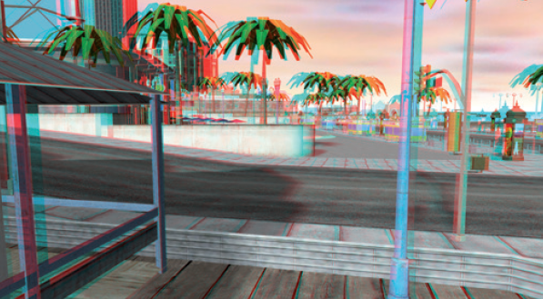
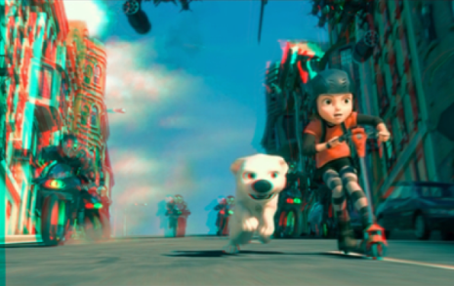
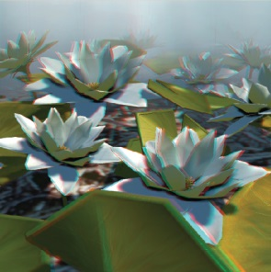
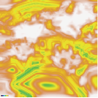
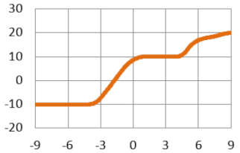
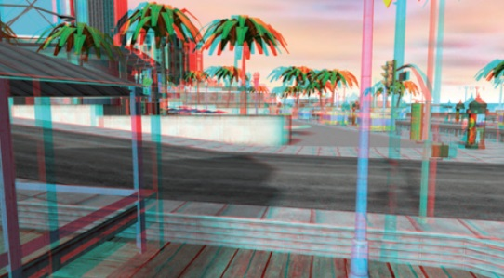
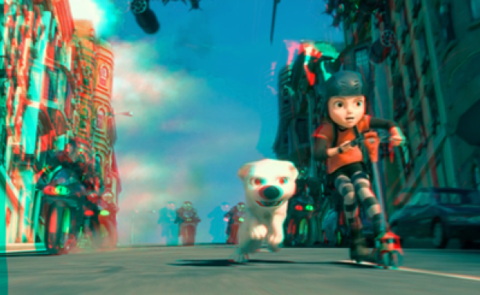
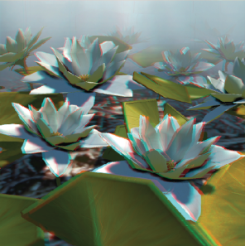
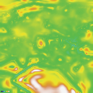
Disparity manipulation
Output disparity
Perceived distortions
strong
Input disparity
weak
Perceived distortions
Slide courtesy of Petr Kellnhofer
OSCAM – Optimized stereoscopic camera control for interactive 3D
Oskam et al., SIGGRAPH Asia 2011
Nonlinear disparity mapping
for stereoscopic 3D
Lang et al., SIGGRAPH 2010
A perceptual model for disparity
Didyk et al., SIGGRAPH 2011
Notes:
Source:
Kellnhofer et al.: Optimizing Disparity For Motion in Depth. EGSR 2013.
http://resources.mpi-inf.mpg.de/TemporalStereo/EGSR2013.pptx

Slide 15
Additional reading on viewing comfort
Production rules for stereo acquisition
Zilly et al., Proc. IEEE 2011
Predicting stereoscopic viewing comfort using a coherence-based computational model
Richardt et al., CAe 2011
A luminance-contrast-aware disparity model and applications
Didyk et al., SIGGRAPH Asia 2012
A metric of visual comfort for stereoscopic motion
Du et al., SIGGRAPH Asia 2013
Modeling and optimizing eye vergence response to stereoscopic cuts
Templin et al., SIGGRAPH 2014
What makes 2D-to-3D stereo conversion perceptually plausible?
Kellnhofer et al., SAP 2015
GazeStereo3D: seamless disparity manipulations
Kellnhofer et al., SIGGRAPH 2016
Causes of discomfort in stereoscopic content: a review
Terzic & Hansard, arXiv:1703.04574
Notes:
There is a rich literature on different aspects of viewing discomfort, and you can find these references in the slides on our course website.

Slide 16
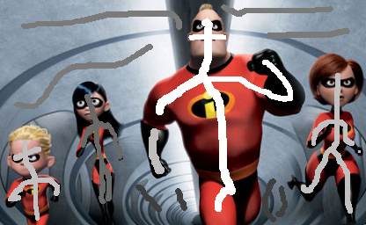
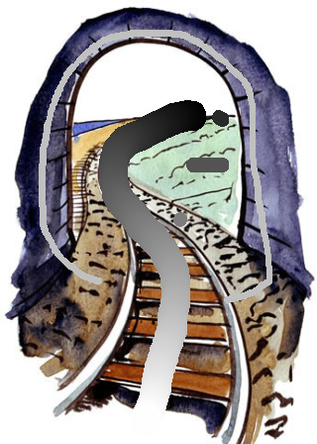
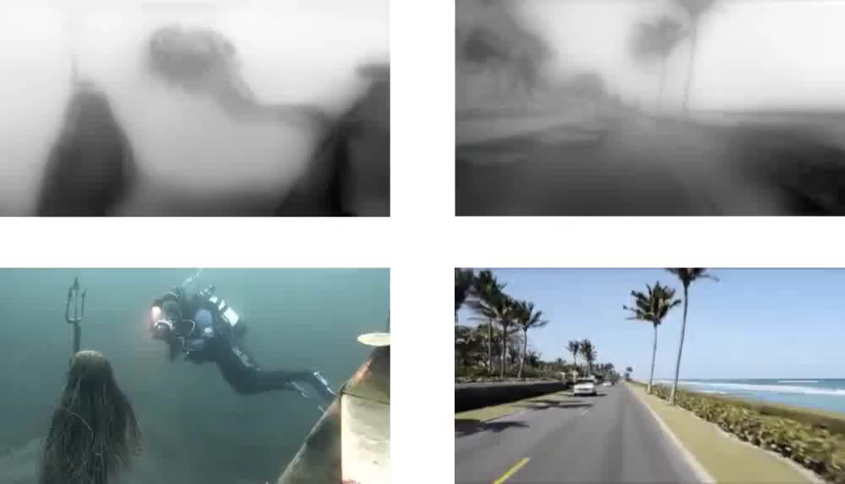
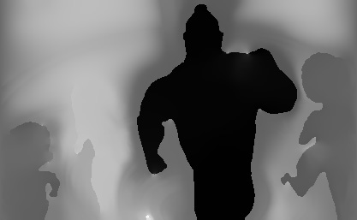
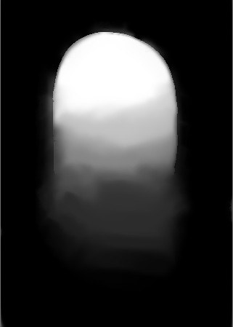
2D-to-3D conversion
©2011 Wang et al./ACM
©2016 Leimkühler et al.
StereoBrush: interactive 2D to 3D conversion
using discontinuous warps
Wang et al., SBIM 2011
Perceptual real-time 2D-to-3D conversion using cue fusion
Leimkühler et al., IEEE TVCG 2017
Notes:
However, most images and videos are not available in stereoscopic 3D, so 2D-to-3D conversion is an important task in practice.
Techniques such as StereoBrush by Oliver Wang and colleagues propagate sparse strokes to a per-pixel disparity map, which is then used for warping the image to create the left and right views of stereoscopic 3D.
Other techniques are fully automatic, such as this work here on the right by Thomas Leimkühler and colleagues. Their system extracts multiples depth cues and merges them into the disparity maps at the top.
But these are not the only approaches …
Sources:
Leimkühler et al., GI 2016 Slides (http://resources.mpi-inf.mpg.de/StereoCueFusion/GI2016_slides.pptx), slide 25
Wang et al., SBIM 2011, Figure 8

Slide 17
Additional reading on 2D-to-3D conversion
Deep3D: fully automatic 2D-to-3D video conversion
with deep convolutional neural networks
Xie et al., ECCV 2016
Hallucinating stereoscopy from a single image
Zeng et al., CGF (Eurographics) 2015
Video stereolization: combining motion analysis with user interaction
Liao et al., IEEE TVCG 2012
Depth Director: a system for adding depth to movies
Ward et al., IEEE CG&A 2011
Stereoscopic video synthesis from a monocular video
Zhang et al., IEEE TVCG 2007
Notes:
… there are quite a few more, which you can read up on if you are interested.

Slide 18
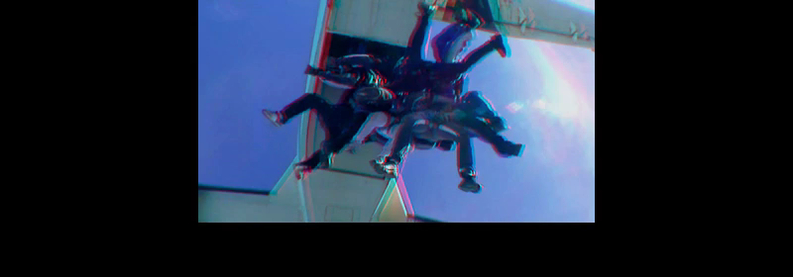
Video de-anaglyph
©2014 Roo & Richardt; video: Eric Deren/Dzignlight Studios
Temporally Coherent Video De-Anaglyph
Roo & Richardt, SIGGRAPH Talks 2014
Notes:
Some stereoscopic 3D content might not be available as separate left and right views, but only as anaglyph content.
For these cases, Joan Sol Roo and I proposed a method for reconstructing the full-colour left and right views in a temporally coherent way by de-anaglyphing the input video.
[single-image approaches: Pao et al., ICCV 2015; Joulin & Kang, CVPR 2013]
Source:
Roo & Richardt, SIGGRAPH Talk 2014, supplemental video

Slide 19
Stereo 3D video deblurring
Blurry input image
Deblurred image
©2016 Sellent et al.
©2017 Pan et al.
Simultaneous stereo video deblurring and scene flow estimation ↑
Pan et al., CVPR 2017
Stereo Video Deblurring
Sellent et al., ECCV 2016
Notes:
Once a video is available in stereoscopic 3D, it also becomes more difficult to edit, as anything done in one view should also be done consistently in the other view.
Any inconsistency between the two views can again cause visual discomfort, as it makes it difficult for the human visual system to figure out what is going one.
So for example, Liyuan Pan and colleagues proposed a method for simultaneous stereo video deblurring last week at CVPR.
This method removes motion blur consistently from both views by simultaneously estimating the correspondence between the two stereo views.
[Anita Sellent and colleagues]
Sources:
Pan et al. figures from arXiv source (https://arxiv.org/abs/1704.03273)

Slide 20
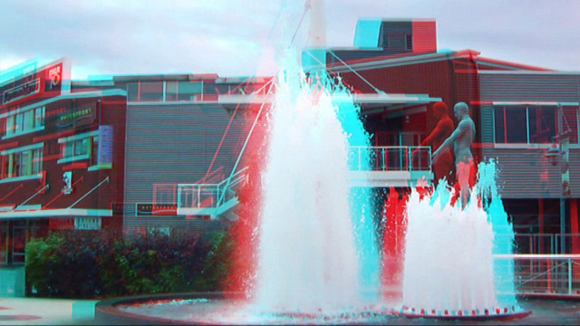
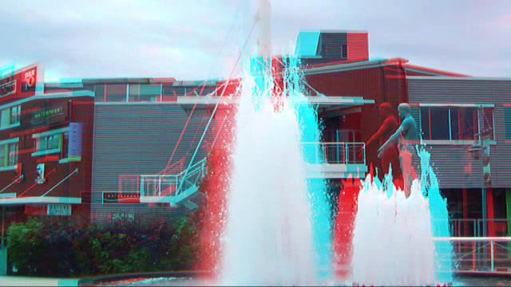
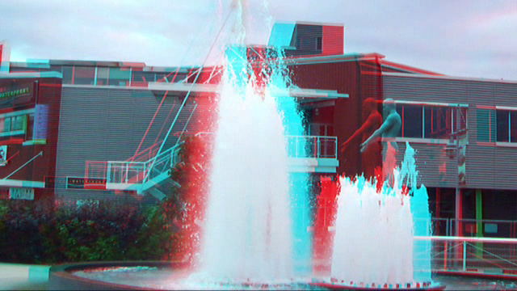
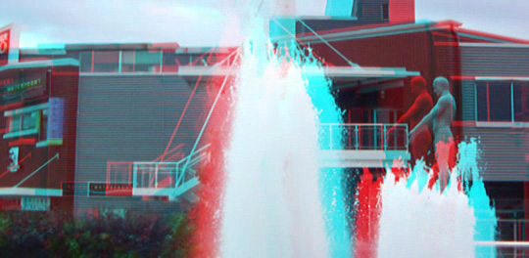
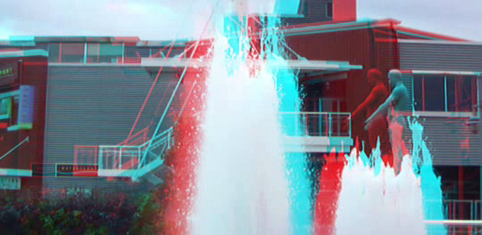
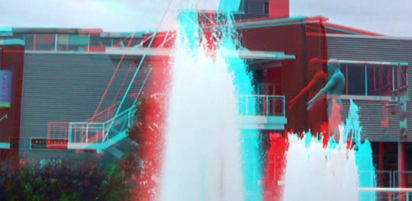
Stereo 3D video stabilisation
Input video frames (anaglyph)
Stabilised video frames (anaglyph)
©2013 Liu et al./IEEE
Joint Subspace Stabilization for Stereoscopic Video
Liu et al., ICCV 2013
Notes:
Video stabilisation is another example for a video processing technique that needs to be specifically adapted to stereo 3D videos.
@This is because stabilising both input views independently does not guarantee that the disparity remains in tact, and this might also introduce undesirable vertical parallax.
@ The solution by Feng Liu and colleagues is therefore to extend their subspace video stabilisation approach to jointly stabilise both cameras using the same, shared subspace.
Source:
Liu et al., ICCV 2013 (Figure 2)

Slide 21
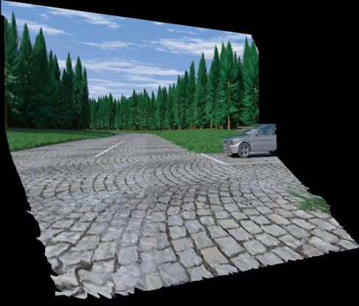
Correspondence finding
← Consistent binocular depth and scene flow with chained temporal profiles
Hung et al., IJCV 2013
Real-time spatiotemporal stereo matching using the dual-cross-bilateral grid
Richardt et al., ECCV 2010
©2013 Hung et al.
Notes:
As shown earlier, the key to consistent editing of stereoscopic 3D videos is to find correspondences between the two input views.
Source:
http://www.cse.cuhk.edu.hk/~leojia/projects/depth/ijcv_depthflow.mp4

Slide 22
Image-only techniques
Retargeting:
  Object-coherence warping for stereoscopic image retargeting
  Lin et al., IEEE TCSVT 2014
  Stereo seam carving a geometrically consistent approach
  Basha et al., IEEE TPAMI 2013
Compositing:
  StereoPasting: interactive composition in stereoscopic images
  Tong et al., IEEE TVCG 2013
  Stereoscopic 3D copy & paste
  Lo et al., SIGGRAPH Asia 2010
Warping:
  Perspective-aware warping for seamless stereoscopic image cloning
  Luo et al., SIGGRAPH Asia 2012
  Enabling warping on stereoscopic images
  Niu et al., SIGGRAPH Asia 2012
Notes:
In the research literature, there are still many video editing tasks that have so far only been applied to stereoscopic 3D images and not videos, for example retargeting (changing the aspect ratio), compositing in 3D, and warping.
Applying these existing image-only techniques to a video will most likely result in flickering, inconsistent results.
Revisiting and extending these techniques to stereoscopic 3D videos, for example using consistent correspondences, remains future work, which I encourage the researchers among you to look into.

Slide 23
Capturing 3D panoramas
Notes:
From stereoscopic 3D videos, I am now moving onto stereoscopic 3D panoramas.
These extend the range of views to a full 360 horizontal degrees, but for the moment lose the temporal dimension of video.
The big question is what is the best way to capture a stereoscopic 3D image in all possible viewing directions?
If we look back at a standard stereo rig @ with two parallel cameras, we can see immediately that it nicely captures what it is in front of it.
[no inter-axial for left/right, so no stereo disparity]

Slide 24
Capturing 3D panoramas
Notes:
So what we could do is to rotate the camera rig about the middle of its baseline, which captures stereoscopic views of all possible directions.

Slide 25
Capturing 3D panoramas

Slide 26
Capturing 3D panoramas

Slide 27
Capturing 3D panoramas
Omnistereo: Panoramic Stereo Imaging
Peleg et al., IEEE TPAMI 2001
Notes:
single camera can capture the same ray space

Slide 28
Capturing 3D panoramas
Capturing 3D panoramas
Omnistereo: Panoramic Stereo Imaging
Peleg et al., IEEE TPAMI 2001

Slide 29
Capturing 3D panoramas
Notes:
consider the light rays for a specific view and extract corresponding vertical image strips that make up an omnistereo panorama

Slide 30
Capturing 3D panoramas
Notes:
picking a different viewpoint results in different image strips and hence a different panorama

Slide 31
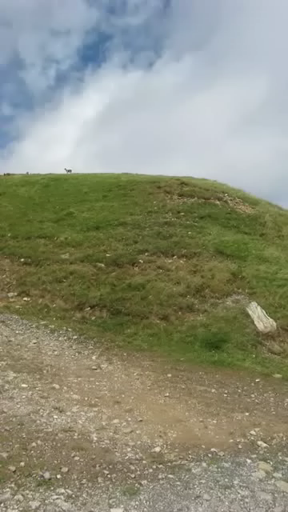
Capturing 3D panoramas
Input video:
©2013 Richardt et al.
Notes:
hand-held capture: challenging dataset

Slide 32

Capturing 3D panoramas
©2013 Richardt et al.
Megastereo: Constructing High-Resolution Stereo Panoramas
Richardt et al., CVPR 2013
Notes:
Project page:
http://richardt.name/megastereo

Slide 33
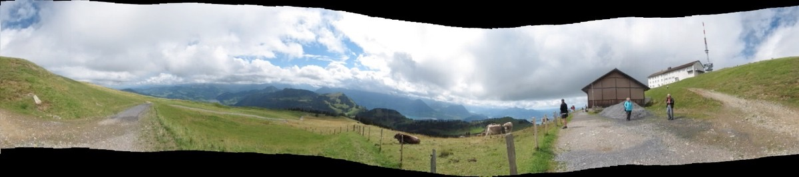
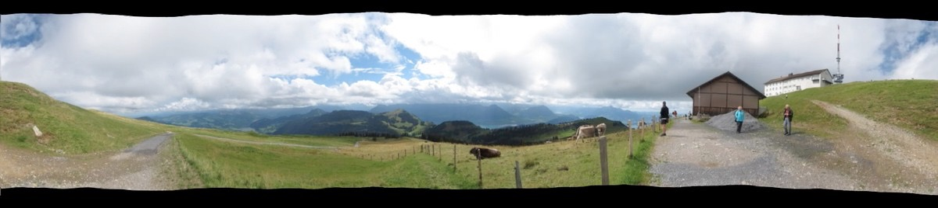
Image alignment
image-based alignment
©2013 Richardt et al.
SfM-based alignment

Slide 34
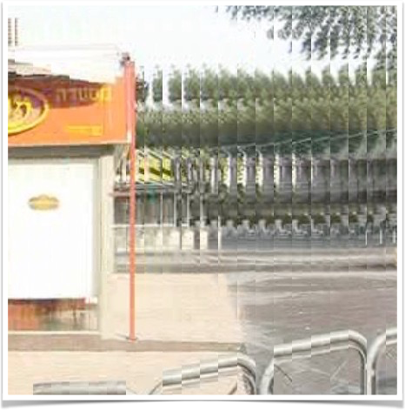
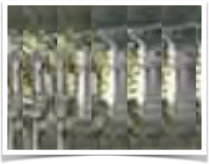
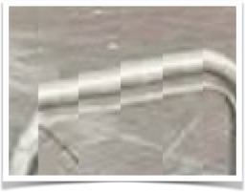
Strip blending artefacts
far: duplication
© dataset ‘refaim’ by Rav-Acha et al., IJCV 2008
near: truncation

Slide 35
Duplication + truncation
panoramic
imaging surface
far objects
near objects

Slide 36

Flow-based ray interpolation
panoramic
imaging surface
far objects
near objects

Slide 37
Strip blending artefacts
far: duplication
© dataset ‘refaim’ by Rav-Acha et al., IJCV 2008
near: truncation

Slide 38
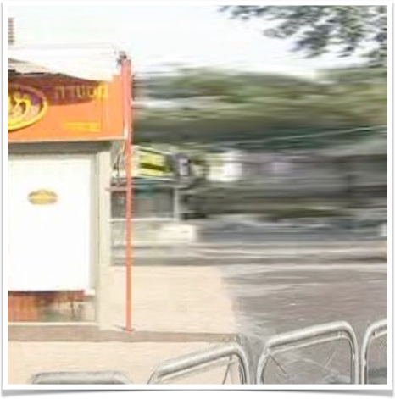
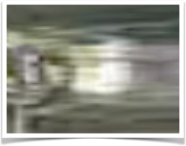
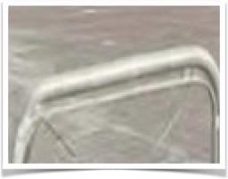
Flow-based blending
far: stretching
©2013 Richardt et al.; dataset ‘refaim’ by Rav-Acha et al., IJCV 2008
near: squeezing
Notes:
Project page:
http://richardt.name/megastereo

Slide 39
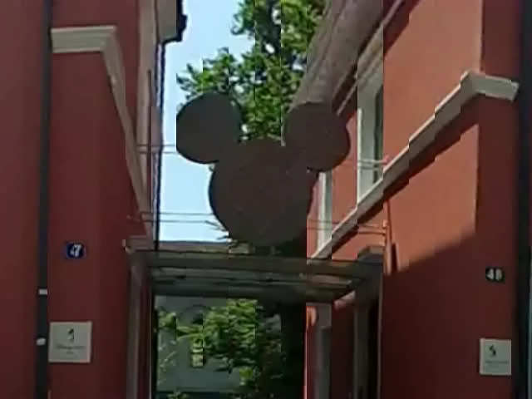

Blending comparison
No blending
Flow-based blending
©2013 Richardt et al.
Notes:
Project page:
http://richardt.name/megastereo

Slide 40
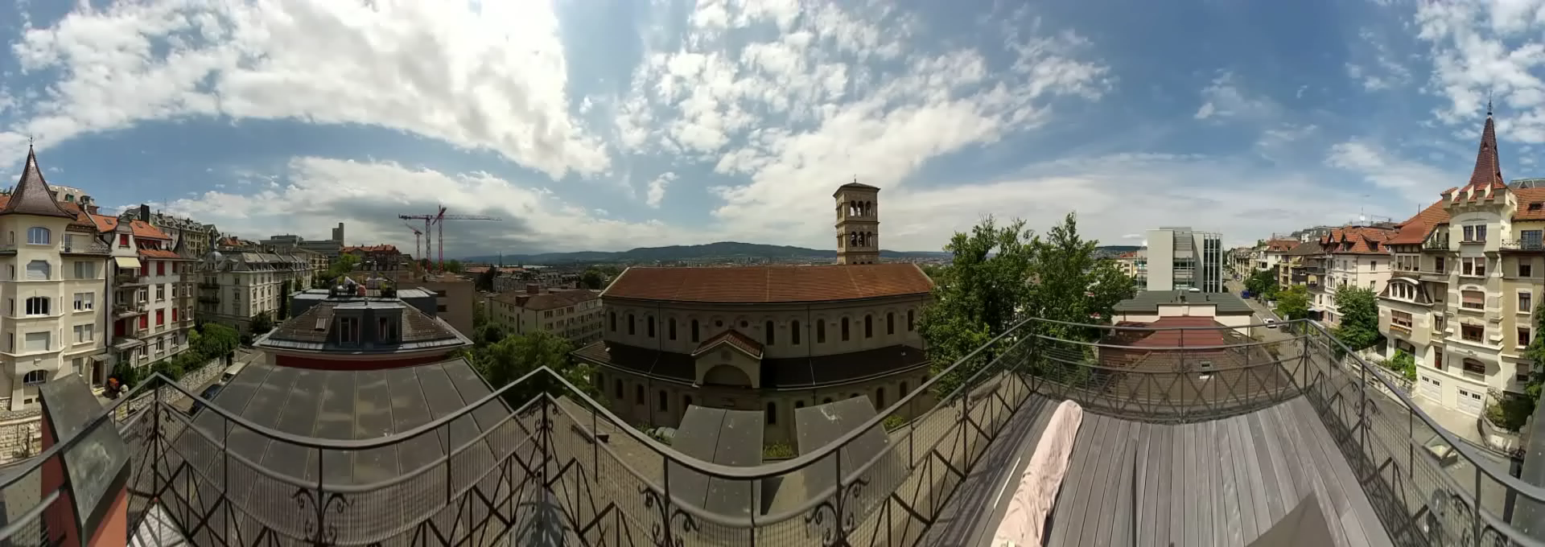
Stereo 3D panorama
©2013 Richardt et al.
Megastereo: Constructing High-Resolution Stereo Panoramas
Richardt et al., CVPR 2013
Notes:
Viewpoint animation = way to illustrate stereo
Project page:
http://richardt.name/megastereo

Slide 41
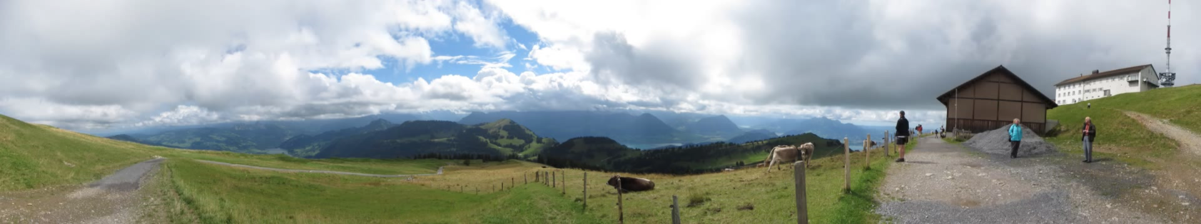
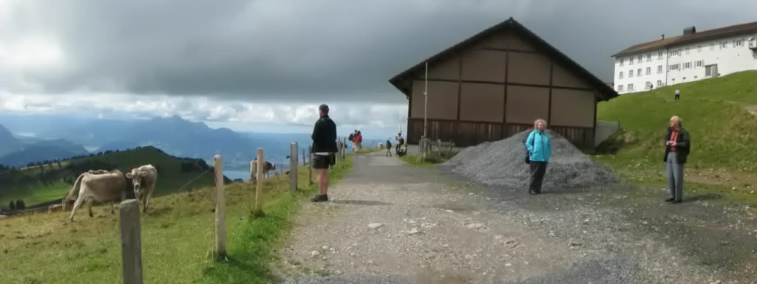
360 º
zoom
©2013 Richardt et al.
Notes:
224 images, 720p (portrait) => 7.8 MP
Project page:
http://richardt.name/megastereo

Slide 42
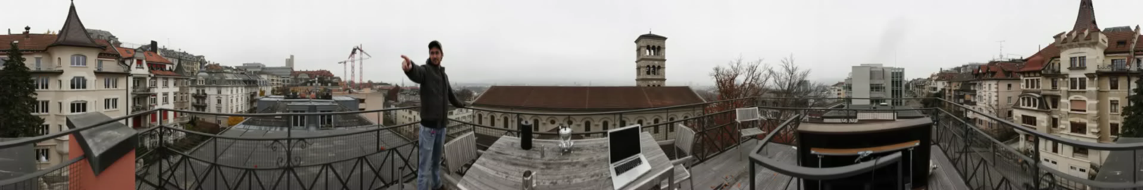


360 º
140 MP stereo panorama
©2013 Richardt et al.
100% zoom
Notes:
215 images, 21 MP => 140 MP
Project page:
http://richardt.name/megastereo

Slide 43
Quick recap
stereo video = videos for left + right eyes
  good: binocular disparity provides depth perception
  bad: does not react to head motion
accommodation–vergence conflict:
  excessive disparity causes viewing discomfort
editing stereo video needs to preserve consistency of views
  many tasks still difficult to achieve, even with research software
high-quality stereo panoramas created with Megastereo
  SfM-based alignment + flow-based blending

Slide 44
Stereoscopic 3D Videos and Panoramas
Questions?
Oliver Wang
360° Video
Christian Richardt
Notes:
This brings me to the end of my talk on stereoscopic 3D videos and panoramas.
I thank you very much for your attention.
@ At this point, I would like to open up the floor for any questions on the first part of our course on the technical background.

